Slide 1
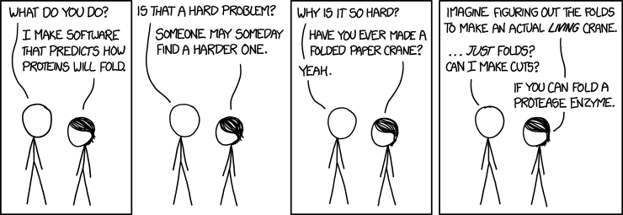
The important thing is not to stop questioning. Curiosity has its own reason for existing. One cannot help but be in awe when he contemplates the mysteries of eternity, of life, of the marvelous structure of reality. It is enough if one tries merely to comprehend a little of this mystery every day. Never lose a holy curiosity.
– Albert Einstein
Mistakes are at the very base of human thought feeding the structure like root nodules. If we were not provided with the knack of being wrong, we could never get anything useful done.” – Lewis Thomas

Slide 2
Announcements
Blackboard Quiz #2 due Sunday, Sept. 4, 11:59 pm.
http://www.nature.com/news/the-tiniest-lego-a-tale-of-nanoscale-motors-rotors-switches-and-pumps-1.18262
Article discusses bio-inspired nanomotors ‘the tiniest Lego’.

Slide 3
Clicker question: A common way to disrupt molecules is by heating them. If there are typically three stages of disruption as the temperature is increased, which bonds might this correspond to (in order of increasing temperature)?
Covalent, hydrogen, van der Waals
Van der Waals, hydrogen, covalent
Ionic, hydrogen, polar covalent
Ionic, hydrogen, non-polar covalent
Notes:
Answer is B

Slide 4
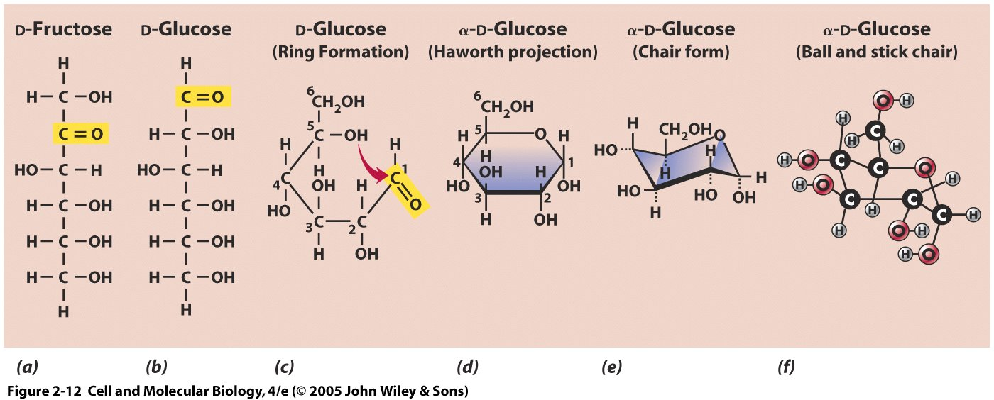
Glucose structure as a carbohydrate example
Molecular diversity can be generated by:
Molecular composition
Bond orientation
Stereoisomers
Glucose is a 6 carbon aldose sugar because it ends in an aldehyde
Ketose sugars are another common class of carbohydrate (e.g. fructose)
Most 5+ carbon sugars in cells are in the more energetically favorable ring formation
Notes:
The numbering of the carbon atoms follows the rules of organic chemistry nomenclature, such that the aldehyde carbon is referred to as C-1 and the carbonyl group in ketoses is C-2.
The Types of Biological Molecules: Carbohydrates
I. Carbohydrates comprise a group of substances, including simple sugars (monosaccharides) & larger molecules made from them
A. Serve primarily as chemical energy storehouse & durable building material for biological construction
B. Most have general formula (CH2O)n
1. Important ones in cell metabolism have from 3 to 7 carbons (n = 3 - 7)
2. Trioses, tetroses, pentoses, hexoses, & heptoses - 3, 4, 5, 6, & 7 carbons, respectively
II. The structure of simple sugars – each sugar molecule consists of carbon atom backbone linked together in linear array by single bonds
A. Each carbon of backbone is linked to single OH group except for one bearing carbonyl (C=O) group
1. Ketose - carbonyl group found at internal chain position; forms ketone group (e. g., fructose)
2. Aldose - carbonyl group at one end of sugar forms aldehyde group (e. g., glucose)
B. Sugars with 5 or more carbons convert by self-reaction into closed, ring-containing molecule with H's & OH's above or below ring; ring not planar but in 3D-conformation resembling chair
The above self reaction occurs in glucose as it forms a ring. The double bond on C1 gets an H (is reduced) and the alcohol on C5 (R-OH) becomes an ester (R’-O-C)

Slide 5
Clicker question: Multiples enzymes act on phospholipid molecules. Which of the following is NOT a way that they would distinguish between different phospholipids?
Glycerol backbone
Fatty acid chain length
Fatty acid bond orientation
Head group
Notes:
Answer is A

Slide 6
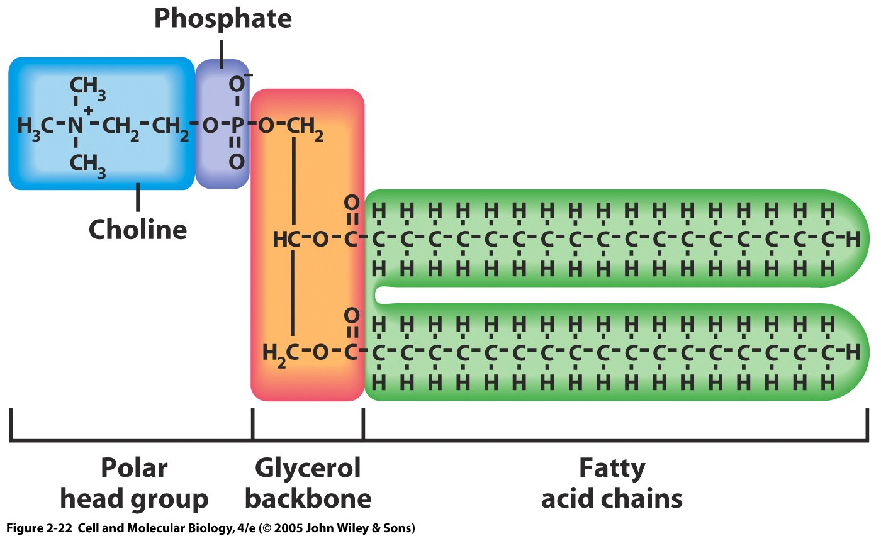
Phospholipid structure
How do you think the phospholipid orients itself in an aqueous environment?
Fatty acids are amphipathic, with a hydrophilic head and a hydrophobic tail
Notes:
How do you think the phospholipid orients itself in an aqueous environment?

Slide 7
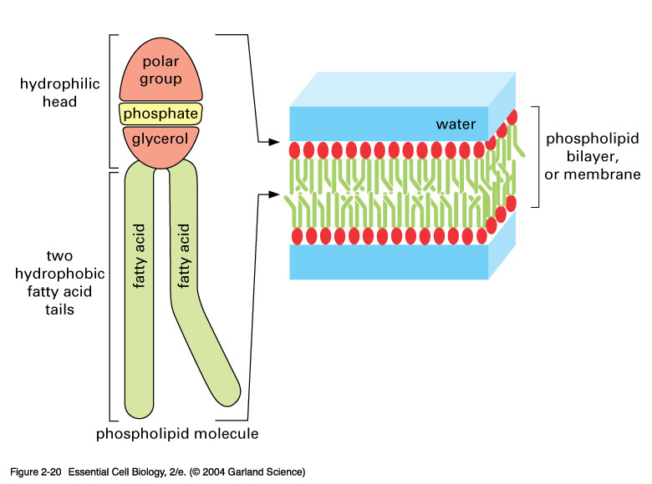
Fatty acids are part of phospholipids which are a major
component of cell membranes
Fatty acids are also a major energy store
Carbohydrates (rapid conversion) and fats (slower conversion) are the two major energy stores in body
Average sized person has about 1 lb. stored carbohydrates and about 35 lbs. stored fat
Notes:
02_20_lipid membranes.jpg

Slide 8
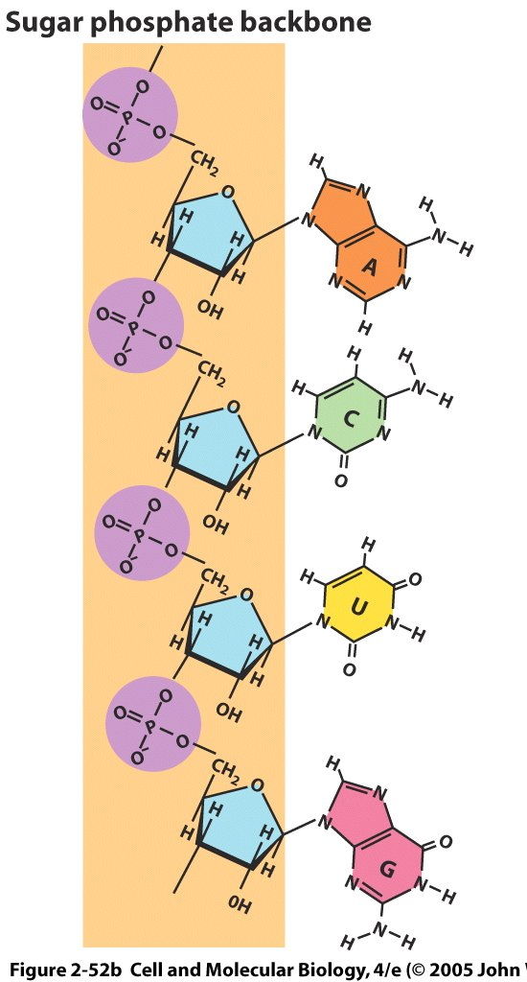
Phosphates and sugars make up the nucleic acid backbone.
Bases are linked to the sugars.
The phosphate is normally linked to the 5'-carbon of the sugar
The nitrogenous base is attached to the sugar's 1'-carbon
Monomers polymerize when sugar 3'-OH is linked by ester bond to 5'-phosphate of next nucleotide in chain (3' - 5' phosphodiester linkage); so nucleotides are joined by sugar-phosphate linkages
Notes:
8

Slide 9
DNA pairings
A-T are bonded by two H-bonds. G-C are bonded by three H-bonds.
In RNA, uracil substitutes for thymidine (thymine). Bonds always made between one purine and one pyrimidine, keeping width nearly constant
Notes:
9
Polymerization of Nucleotides and the Double Helix
Individual nucleotide monomers, whether RNA or DNA, are joined together by condensation reactions between the 5'-phosphate group of one nucleotide and the 3'-OH group on the sugar of another nucleotide. The resultant bond is called a 3'-5' phosphodiester bond. The bond connects the 3' and 5' carbons of successive nucleotides in the chain. It is a combination of two phosphate esters which accounts for the rest of the name. The resultant chain has a 5' -> 3' polarity. In DNA, these polynucleotide chains usually come in pairs and they are antiparallel. A base in one chain pairs with the complementary base in the opposite chain. For example, a thymine nucleotide in one chain will pair with an adenine nucleotide in the opposite chain and a cytosine nucleotide will pair with a guanine nucleotide. This complementary relationship also explains the ability of DNA to replicate, an essential feature of the genetic material and its ability to pass the genetic code on to complementary RNA molecules that carry the code to the site of protein synthesis. The double stranded DNA that forms as a result of the pairing resembles a spiral staircase in shape. The phosphate-sugar backbone, which is hydrophilic will form the railings of the staircase. The paired nitrogenous bases represent the actual stairs. The hydrophilic backbone essentially covers the outside surface of the molecules, while the hydrophobic paired bases are sheltered from water in the interior of the helix.

Slide 10
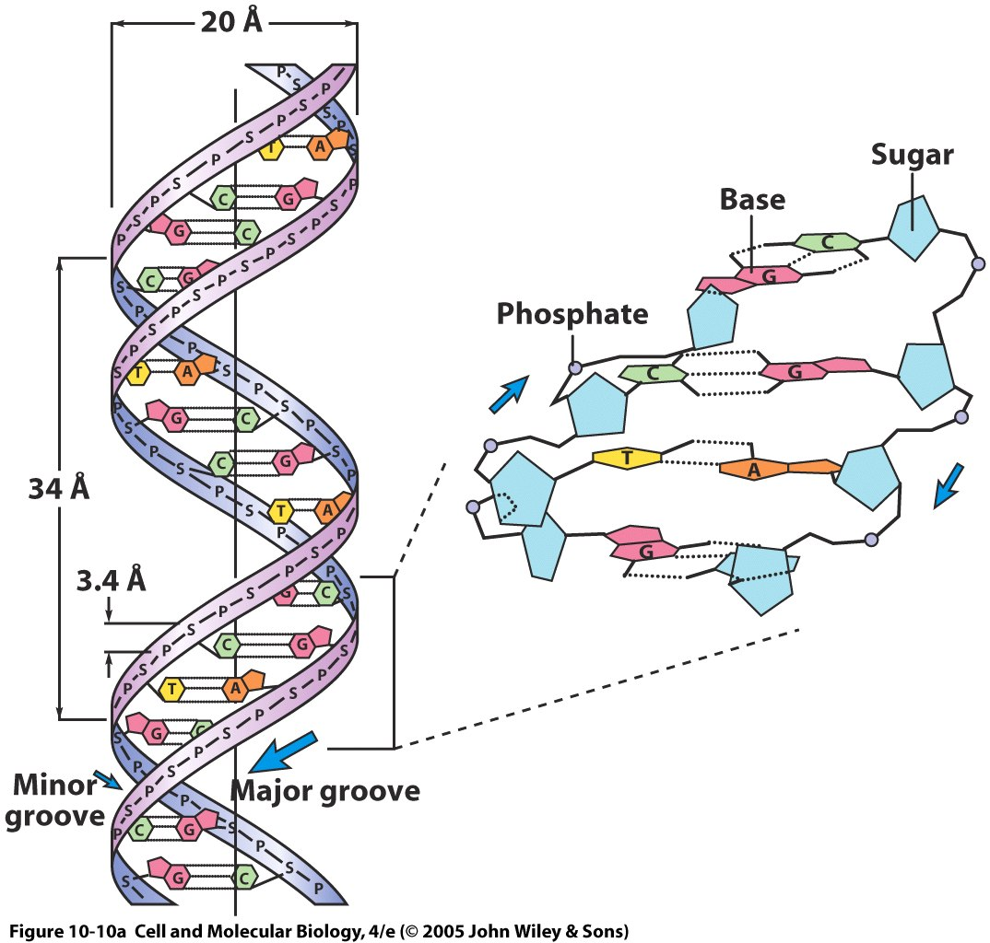
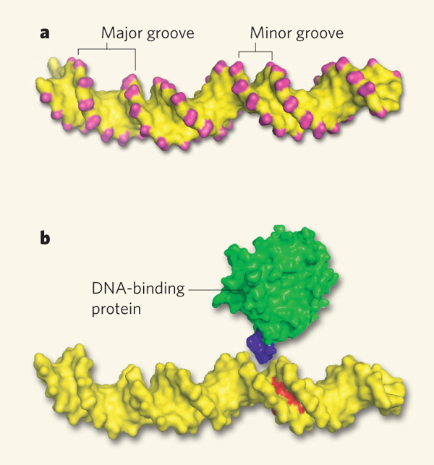
Structure of double helix
Notes:
This is a “right-handed” helix, turning clockwise
Proteins often fit into either the major or minor grooves, and some can bind without separating the DNA strands
Right hand figure from:
Structural biology: DNA binding shapes up
Tom Tullius
Nature 461, 1225-1226(29 October 2009)
doi:10.1038/4611225a
back to article
10

Slide 11
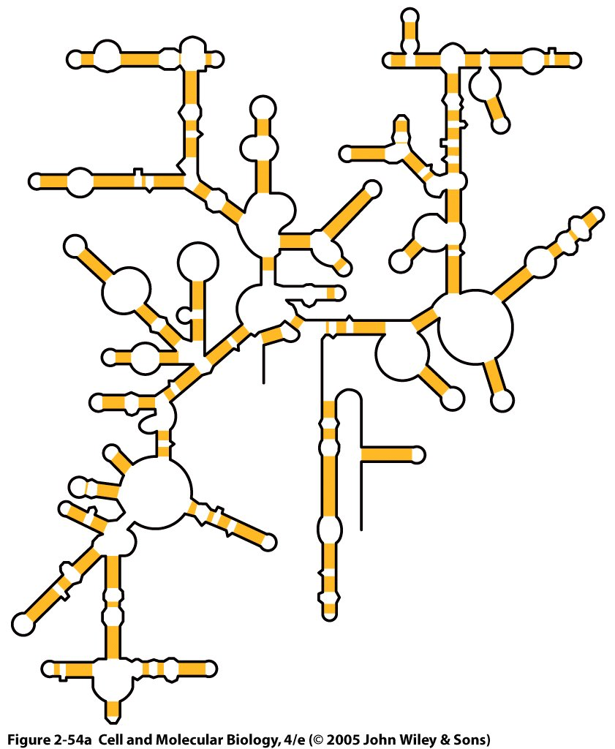
RNA can have complex shapes due to complementary RNA sequences that are nearby or distant
Unlike DNA, RNA is usually single stranded. However, portions of a single strand of RNA are complementary to other portions, so they can form double strands and have interesting, repeatable secondary and tertiary structures.
For example, this is how tRNA gains its specificity for recognition by mRNA.
Notes:
11
V. General structure and function of DNA/RNA
A. Sequence of bases determines specificity of DNA/RNA & encodes hereditary information for synthesis of proteins
B. RNA is usually single-stranded, but can fold back on itself to form frequent double stranded regions with local H-bond pairing (just like in DNA) & complex 3° structures
1. With DNA, it directs & carries out protein synthesis, but ……
2. Some RNAs do not carry genetic information but can be structural and/or enzymatic (rRNA)

Slide 12
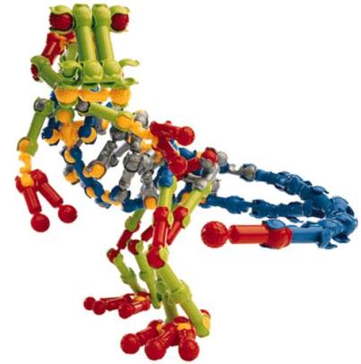
Protein versatility and specificity come from their incredible structural flexibility There are 4 hierarchical levels of protein structure
Primary: amino acid sequence
Secondary: Repeating conformations of local sections of a protein (e.g. alpha-helix, beta-pleated sheet)
Tertiary: Large scale conformation of multiple sections of a protein, often separated by many amino acids
Quaternary: Combination of multiple protein subunits to form a larger protein complex
Lego/Zoob analogy

Slide 13
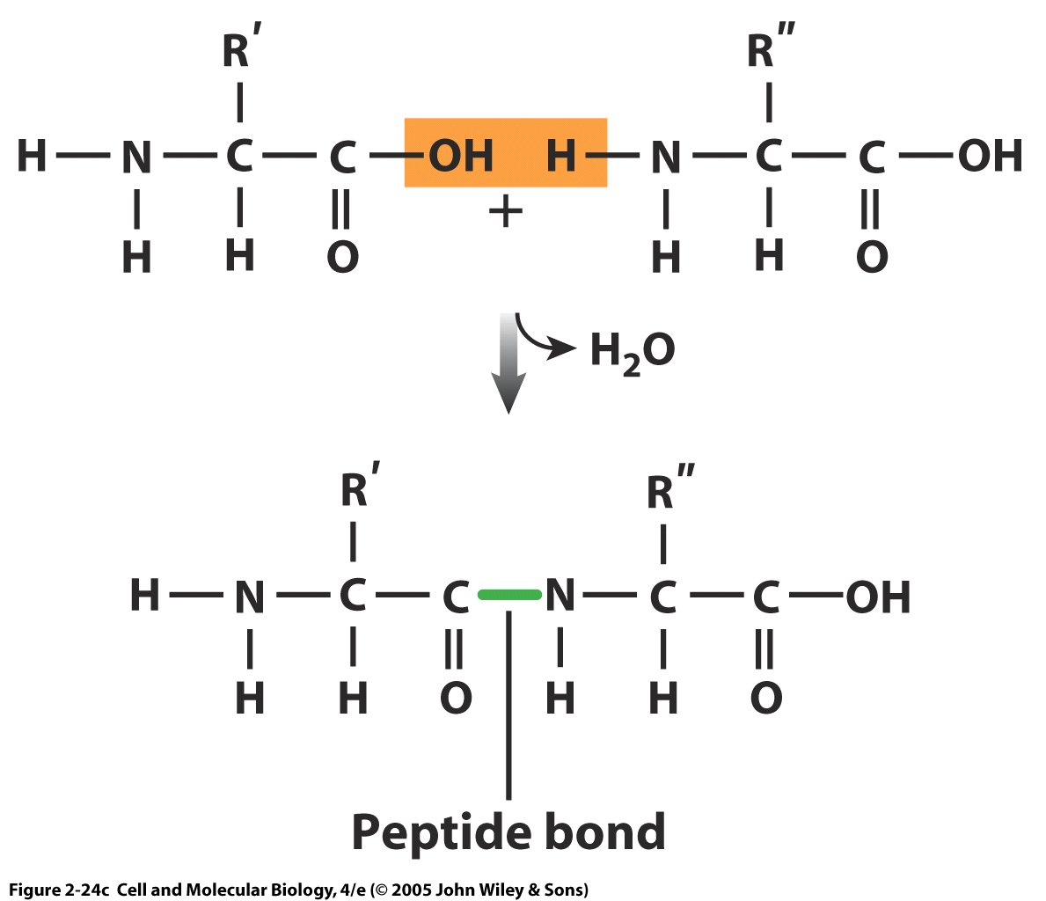
Amino acids are linked by covalent peptide bonds
amine
acid
Bonds are formed by condensation (dehydration) between the acid (carboxyl) end of one amino acid and the amino group of the other.
Loses a water in the process.
Notes:
1. Amino acid backbone is a-carbon between NH2 & COOH groups; all but one (glycine) have symmetric centers so there are 2 stereoisomers D- & L-amino acids; only L-form in proteins

Slide 14
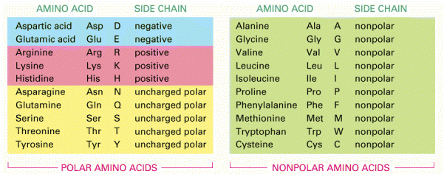
List of amino acid side chains classified by charge at normal intracellular pH (~7.4)
Negative
Positive
Polar (uncharged)
Nonpolar
Nonpolar side chains have different lengths to confer different protein flexibility and spacing
Charge is also determined by local pH
Alberts et al. Molecular Biology of the Cell
Notes:
There are 20 side chains that differentiate amino acids. They can be categorized into 4 main groups based on their charge at physiological pH (which is?, 7.4).
Aspartic acid and glutamic acid are negative at physiological pH (why?, because they already donated their hydrogen).
Arginine, Lysine, and Histidine are positive because they have accepted a hydrogen. These are hydrophilic and the most reactive side chains.
Next come the uncharged polar side change. Because they have electronegative atoms such as N or O in their side chains, they have partial charges and are hydrophilic.
The remainder of the amino acids are nonpolar and hydrophobic. Let’s take a closer look at the side chains and some of their properties that will be important in determining protein structure.

Slide 15
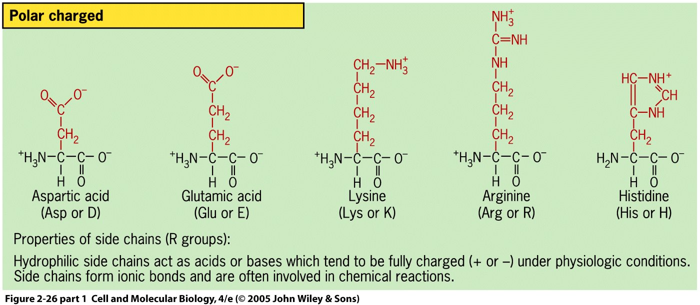
Polar charged side chains are charged, hydrophilic, and reactive at physiological pH (7.4)
Acid side chains have donated a proton, H⁺, so they are now negatively charged
Basic side chains have accepted a proton, H⁺, so they are now positively charged

Slide 16
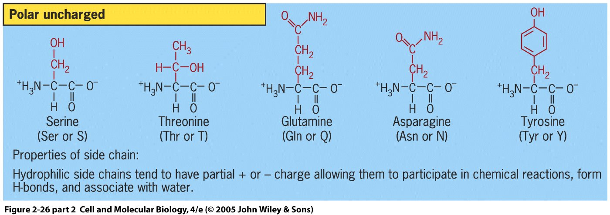
Polar uncharged side chains are partially charged, hydrophilic, and reactive at physiological pH (7.4)
Glutamine and asparagine are similar to glutamic acid and aspartic acid, but the charged O- has been replaced by an uncharged NH2 amine.

Slide 17
pH review and pH range in cells
pH= -log₁₀[H⁺]
pH=7 is a neutral pH
pH<7, more acidic
Such as sulfuric acid H₂SO₄
pH>7, more basic
Such as NaOH, aka bleach
Since log10 scale, each change in 1 pH unit is a 10-fold change in concentration.
As a rule of thumb, each change by 0.3 pH units is a 2-fold change in concentration.
Review your simple logarithms (base 10) and how to work with them!
Blood and intracellular pH are about 7.4
Stomach juice pH=1.8
Roughly 400,000x higher [H⁺] than intracellular pH
pH sensing neurons monitor blood and lung CO₂ levels and are involved in sour taste reception (think citrus fruit)

Slide 18
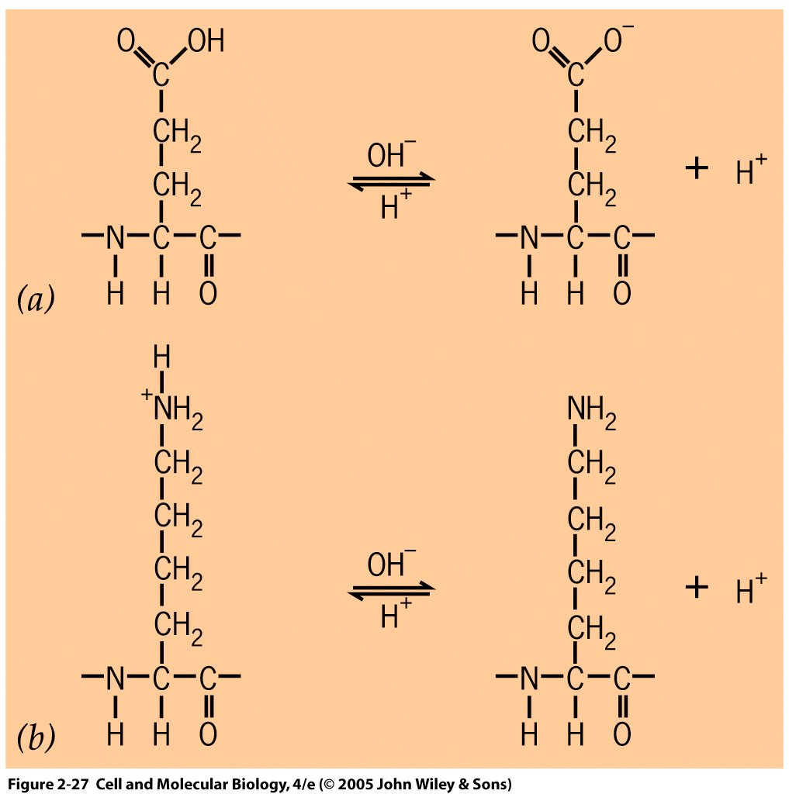
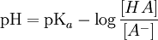
The acid dissociation constant pKa, determines the pH at which 50% of molecules have donated protons
Amino Acid Side Chain | pKa
Asp (D) | 3.8
Glu (E) | 4.3
Arg (R) | 12.0
Lys (K) | 10.5
Cys (C) | 8.28 (-SH)
Tyr (Y) | 10.1
+
(a): Glutamic acid (Glu)
(b): Lysine (Lys)
http://www.chemistry.mcmaster.ca/
Notes:
Another way to write the equation is pH=pKa-[accepted]/[donated]

Slide 19
pKa and pH
What happens when pH = pKa?
What does this mean for [HA] and [A⁻]?
What does this mean for [HA⁺] and [A]?
Notes:
Glu, with 4.3 pka side chain, in either cell pH (7.3) or acidic pH (2.3)

Slide 20
pKa Example - Arginine
The pKa for Arginine is 12.0. At pH = 7.0 (near physiological), what will the ratio of [HA+] to [A] be?
1,000,000
100,000
10
.00001
.0001
Notes:
Answer is B

Slide 21
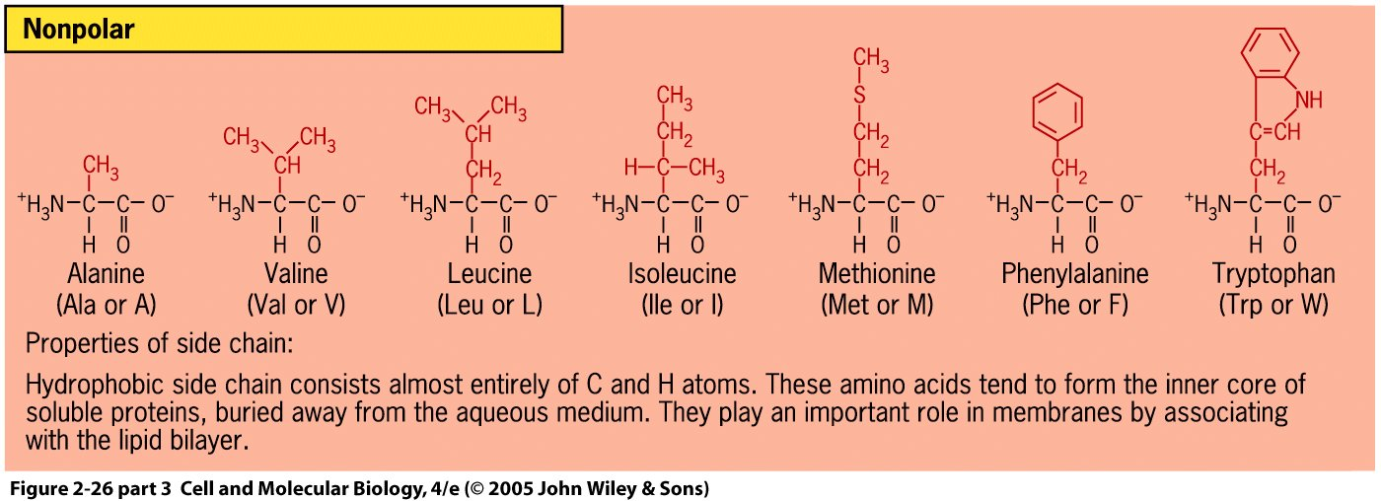
Nonpolar side chains are uncharged, hydrophobic, and weakly reactive at physiological pH
Their roles in protein formation come from their different lengths, conformational flexibility and 3-dimensional shape.
Additionally, methionine has a special role in initiating polypeptide chains during translation (when formylated).

Slide 22
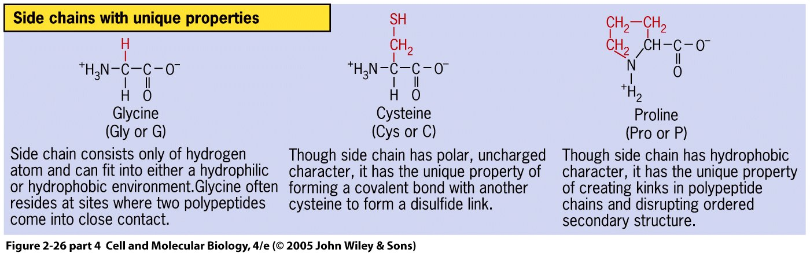
These nonpolar side chains have additional interesting properties.
Glycine: Can be in hydrophobic or hydrophilic environment. Short side chain length allows close contact with other peptides
Cysteine: The sulfur on the end can react with another cysteine to form a covalent disulfide bond that is often used to structurally stabilize proteins.
Proline: This side chain conformation promotes “kinks” in protein structure due to ringed side chain. Often occurs as a transition between different protein sections.
Notes:
The disulfide bridges often occur between sections separated by many amino acids. The proline ringed structure is an imino acid.

Slide 23
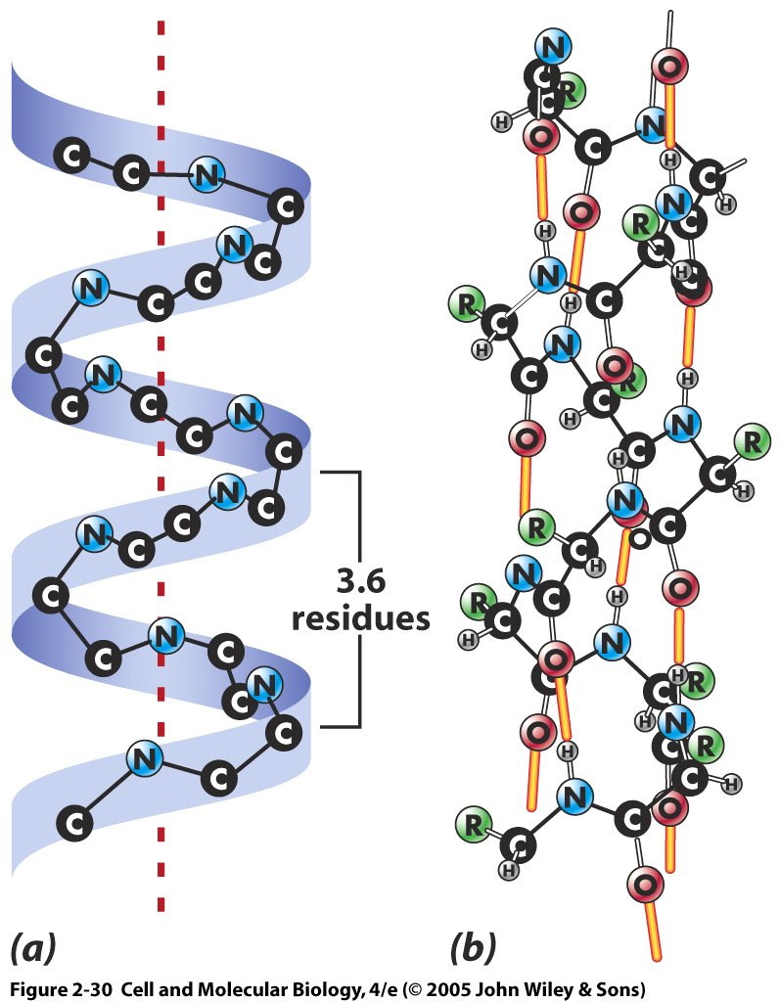
Second string: One major type of secondary structure is the alpha helix conformation
Discovered by Linus Pauling and Robert Corey and confirmed using X-ray crysallography
Stable conformation due to large number of hydrogen bonds (shown in yellow)
Backbone is inside of helix. Side chains project out
For water-soluble proteins, outer surface is polar and hydrophilic and inner surface is nonpolar and hydrophobic
Interactions between residues (amino acids) 4 away from each other important because each turn occurs in 3.6 residues
Notes:
23
Stabilizing hydrogen bonds are forming between the carboxyls and amines, not the side chains

Slide 24
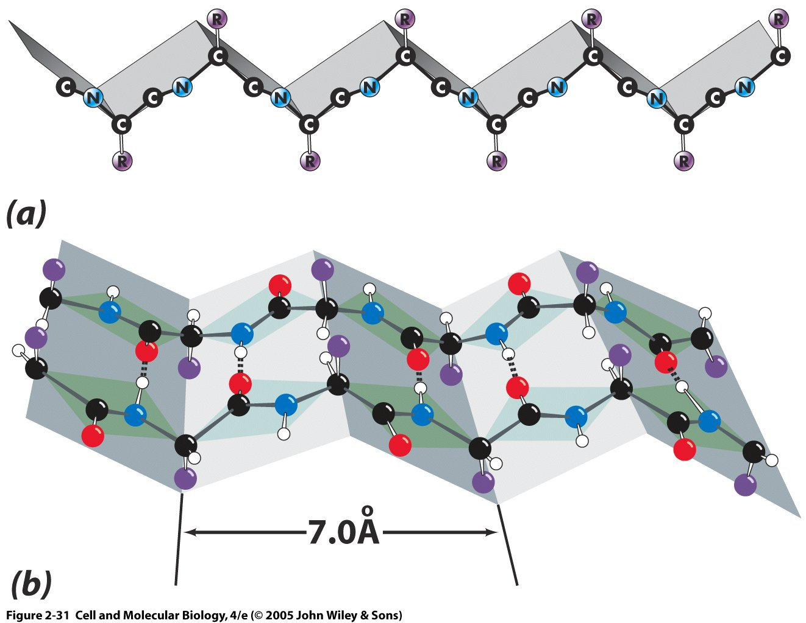
Beta-pleated sheet is the other main type of secondary structure
(a): Beta strand, consisting of one polypeptide backbone
(b): Beta sheet, consisting of beta strands joined by hydrogen bonds
1. Characterized by a large number of H bonds perpendicular to polypeptide chain long axis; project across from one part of chain to another
β strands highly extended; sheet resists pulling (tensile) forces; very strong
Example: silk fibroin
Spider silk is 1/10 thickness of human hair, but roughly 5x stronger than a steel fiber of comparable thickness
Notes:
24

Slide 25
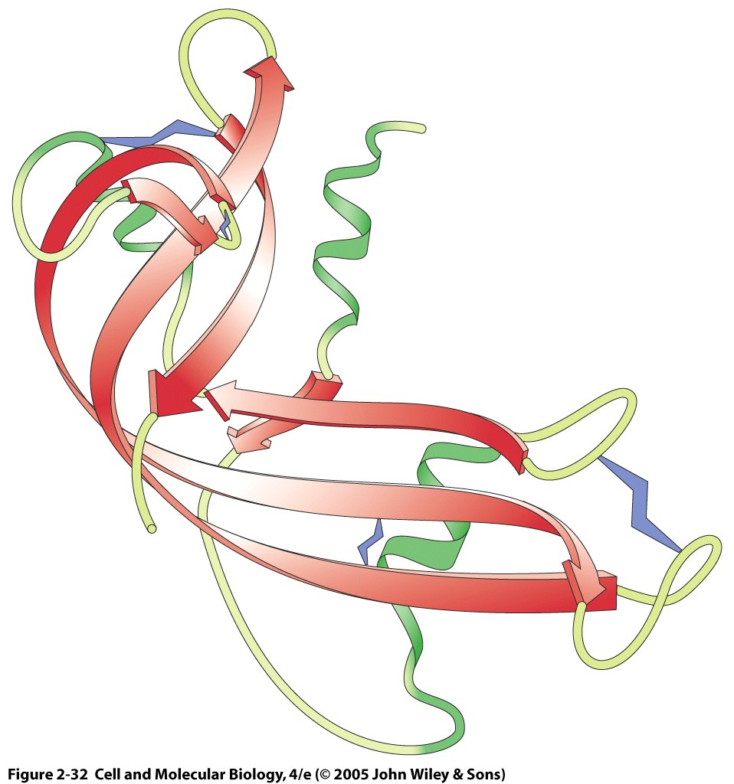
Schematic depiction of secondary structures showing tertiary structure of ribonuclease
Alpha helix (green)
Cysteine disulfide bond
Irregular structure,
Loops and turns
Beta sheet, flat arrows (red)
Irregular regions often sites of greatest biologic activity, Most flexible regions
Notes:
25
Irregular regions often sites of greatest biologic activity, Most flexible regions

Slide 26
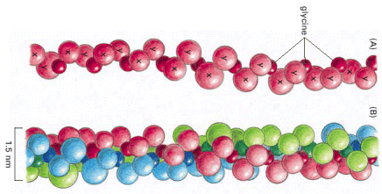
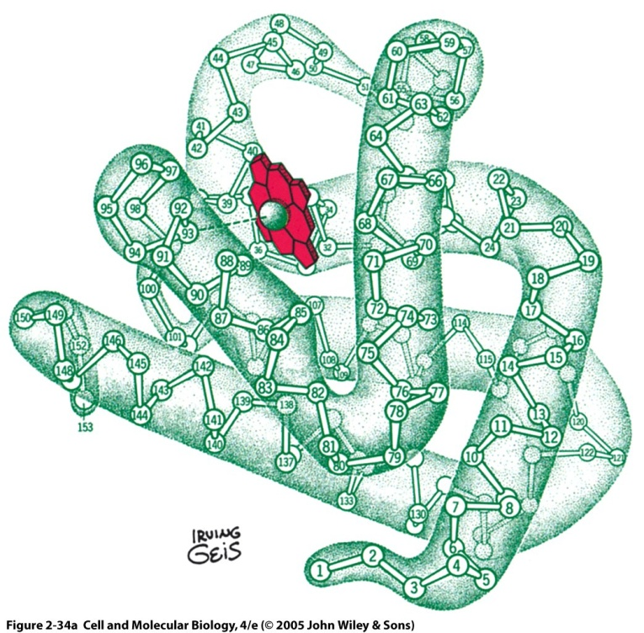
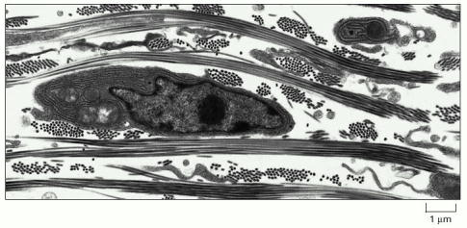
Protein tertiary conformations are typically globular or fibrous
Globular
Myoglobin: important oxygen carrier in muscle
First protein whose tertiary structure was solved
Fibrous
Collagen: important connective tissue
Coiled triple helix gives it great tensile strength
Notes:
26

Slide 27
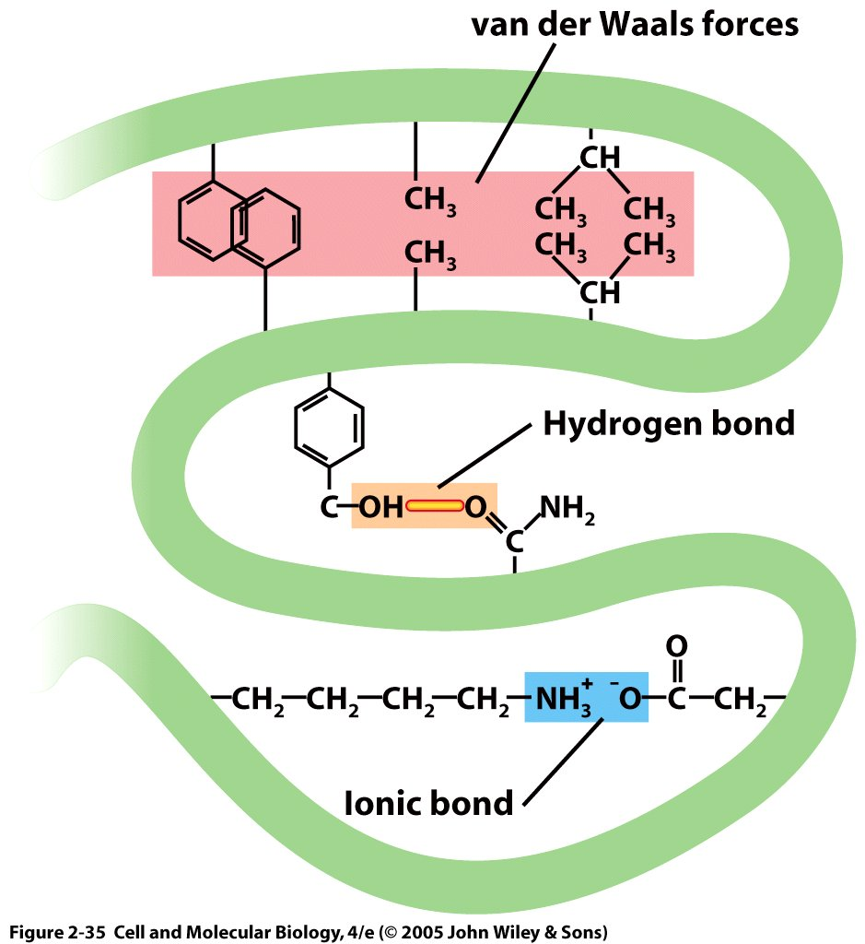
Noncovalent bonds are critical for the formation of protein secondary and tertiary structures from a given amino acid chain (primary structure)

Slide 28
All molecular structures are Gibbs free energy minimizers Protein structures are studied in this manner
ΔG= ΔE +ΔpΔV –TΔS,
G is the Gibbs free energy
E is the energy
p is pressure
V is volume
T is temperature in Kelvin
S is entropy
In most experiments and models within the cell, the +ΔpΔV is assumed to be nearly zero, giving ΔG= ΔE –TΔS

Slide 29
All molecular structures are Gibbs free energy minimizers Protein structures are studied in this manner
Given some starting configuration of a structure, want to minimize G (make ΔG as negative as possible)
Changes in potential energy result from electrostatic interactions (covalent, hydrogen bonds, van der Waals)
“Hydrophobicity results from depriving water molecules of some of their configurational entropy”(from Physical Biology of the Cell)

Slide 30
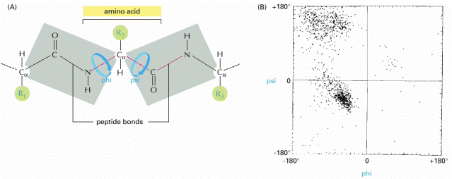
Steric (electrostatic) interactions constrain the motions of polypeptides
Peptide bonds are planar (gray shading). Rotations occur around the alpha carbon
Alberts et al. Molecular Biology of the Cell

Slide 31
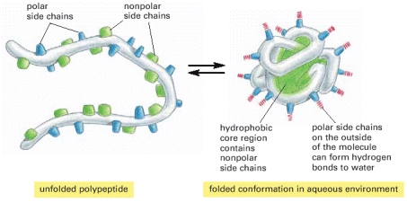
Hydrophobicity also plays an important role in determining protein structure
Alberts et al. Molecular Biology of the Cell

Slide 32
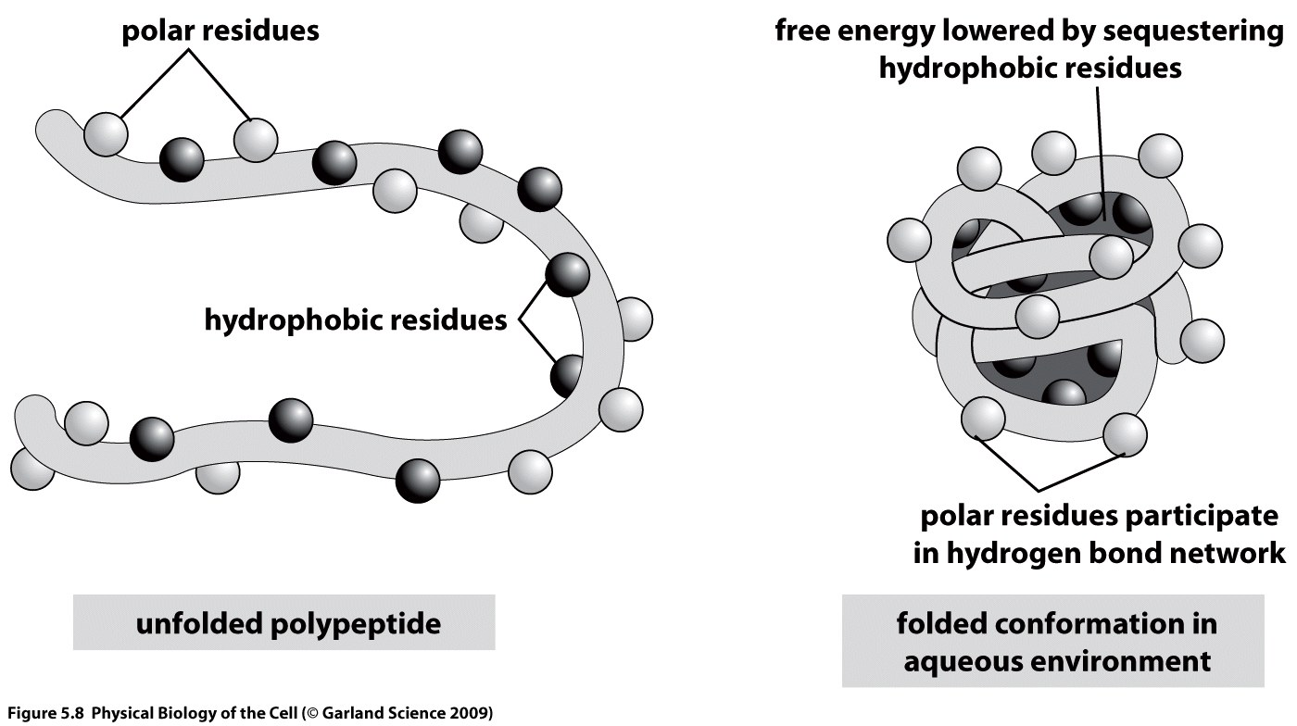
Shielding hydrophobic residues maximizes the entropy of the protein, thereby lowering free energy

Slide 33
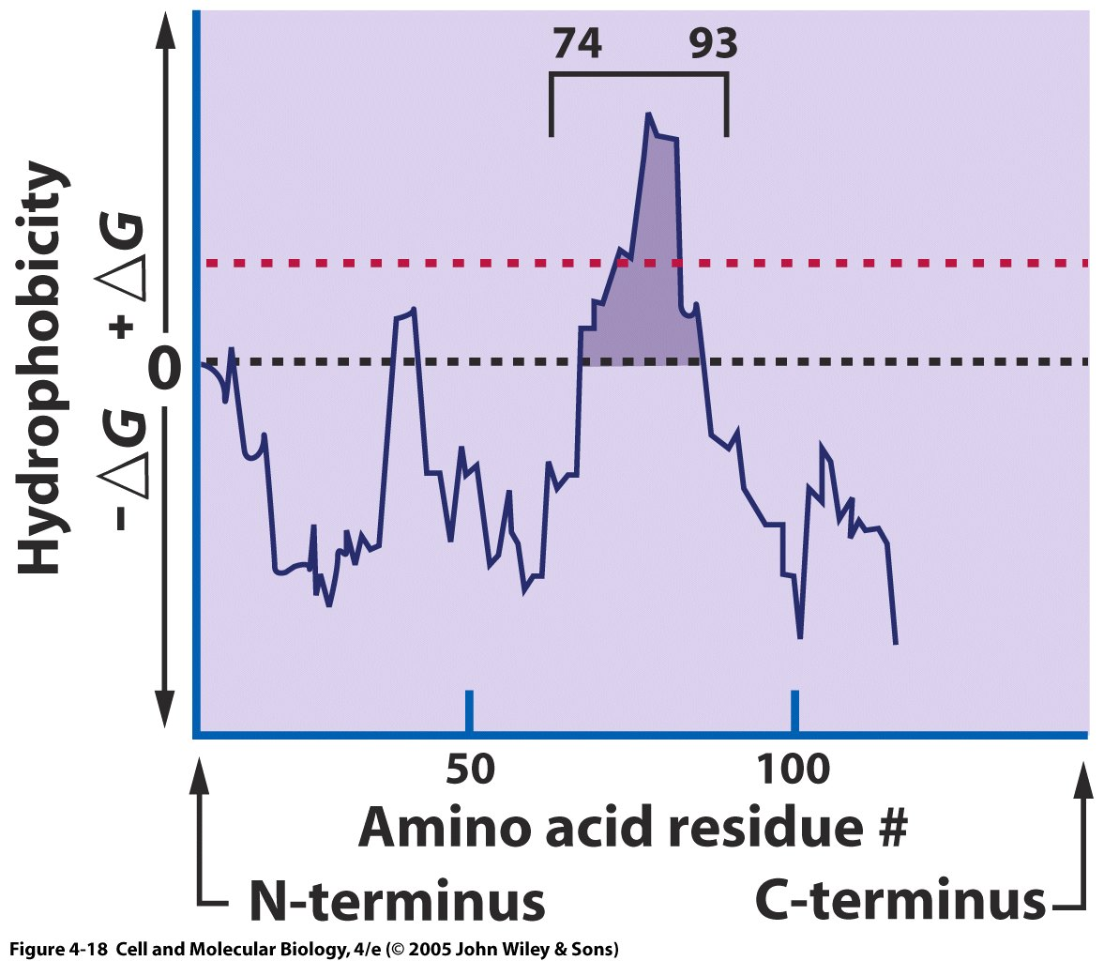
Hydropathy plots are used to identify membrane spanning regions of a protein
Hydropathy plots show the amount of free energy required to move amino acids to an aqueous medium.
Residues 74-93 are hydrophobic and likely to be membrane-spanning

Slide 34
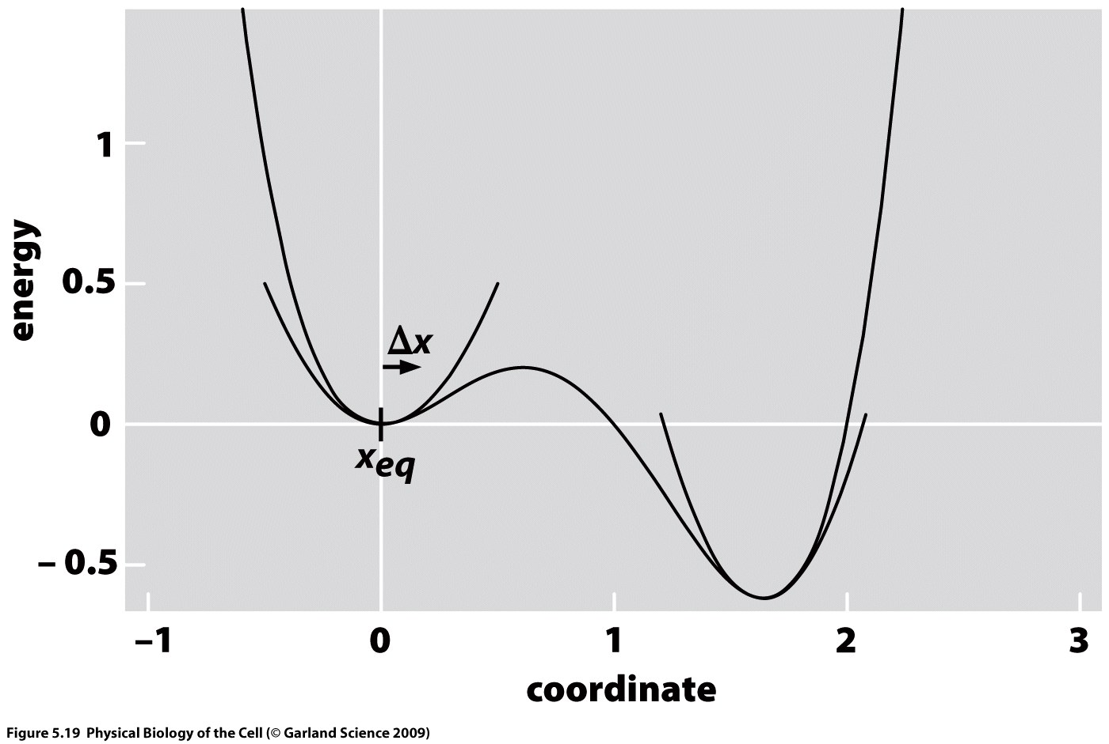
In the vicinity of equilibrium, small deviations can be approximated as a quadratic or a mass on a spring
Notes:
See PBOC equations 5.15 and 5.16
Where U(x+dx) is approx as U(equil) + ½ d²U/dx² |equil dx² which can be considered basically Hooke’s law (spring) with the second partial wrt x as the spring constant k. Force measurements are often easier to make and Hooke’s law can still be applied where F=-k x, where d is the displacement or distance traveled

Slide 35
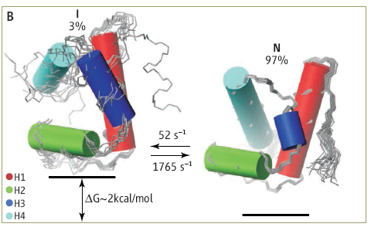
Low probability “excited” states are biologically important, serving as shorter-lived intermediates between more stable states.
Shown is the native (low-energy, energetically favorable) conformation of a protein (N) and its excited intermediate state.
Al-Hashimi 2010
Notes:
HYPA/FBP11 is a small 71-residue, four-helix bundle with H1(a)-H2(a)-H3(310)-H4(a) topology (20) that folds by a three-state mechanism involving an on-pathway intermediate (I): U↔I↔N (14, 21–23). Folding proceeds in two phases, including the fast formation of I from the unfolded state U (microsecond time scale) and a slower, rate-limiting transition from I to the natural state.

Slide 36
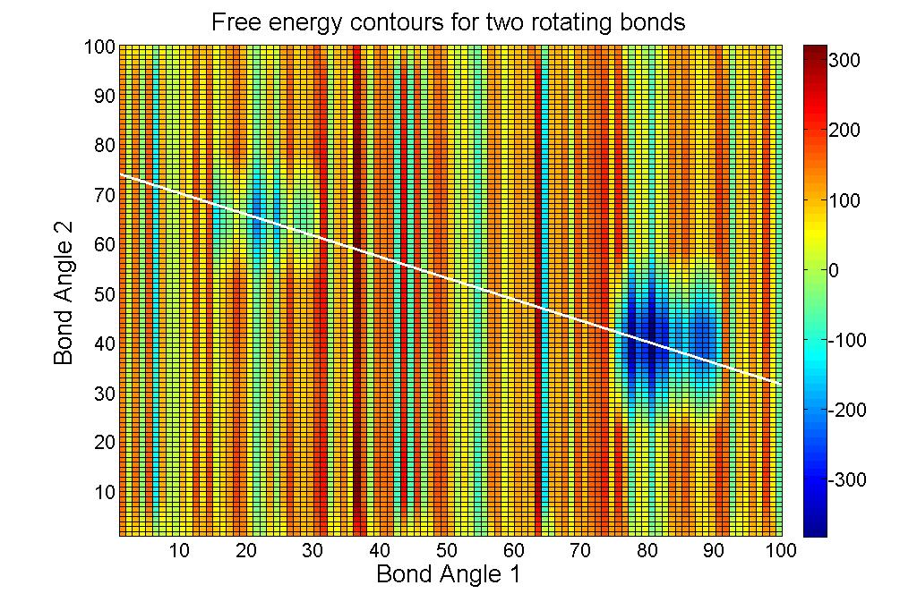
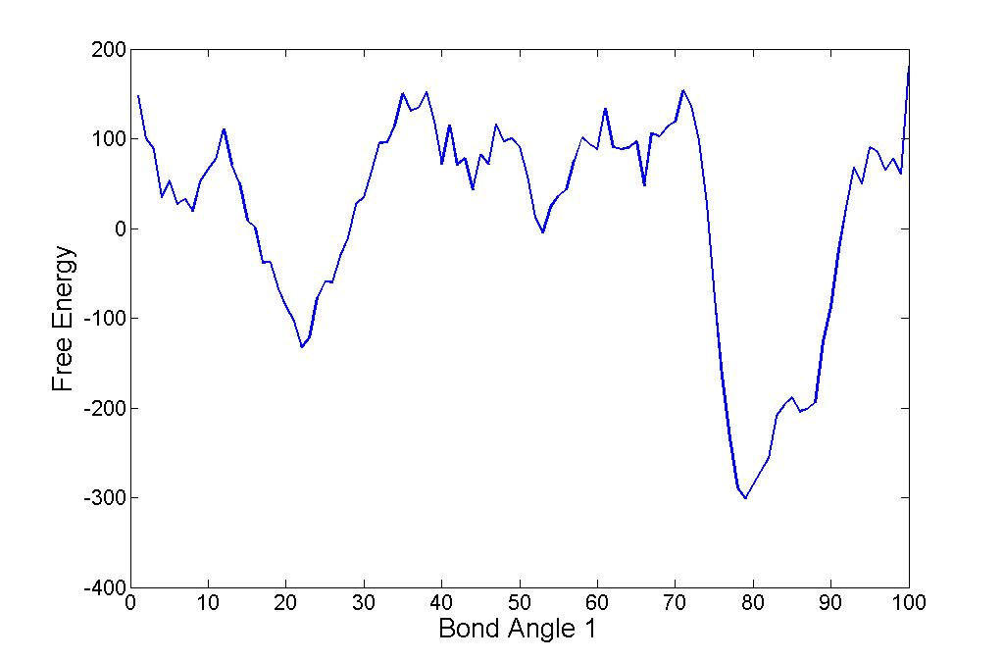
Can compute energetic cost function of different protein configurations to determine stable states
Computationally very expensive for a realistic sized protein
NOTE: A protein can be in a stable state without being in a global free energy minimum
Local minimum (unstable)
Relative minimum (stable)
Global minimum (stable)
Notes:
Bottom plot is free energy contour going along white line in top plot

Slide 37
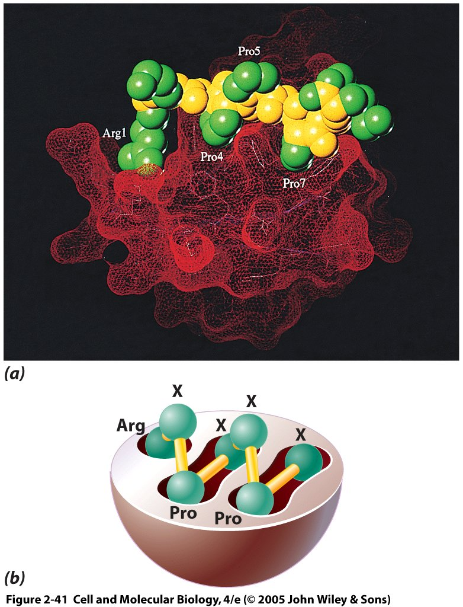
Specificity of protein-protein interactions is due to complementarity of spatial/electrostatic structure (minimizing the free energy again)
Pockets in the SH3 domain of phosphatidyl-inositol-3-OH kinase (red) fit proline rich proteins (yellow and green) well
Grooves shown schematically on bottom
Notes:
37

Slide 38
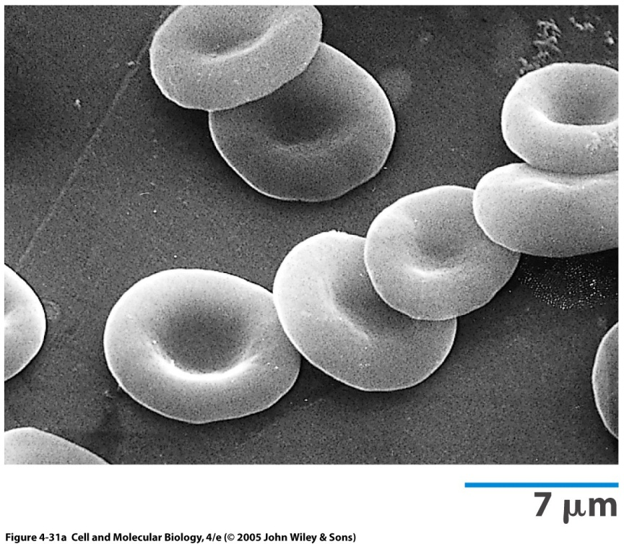
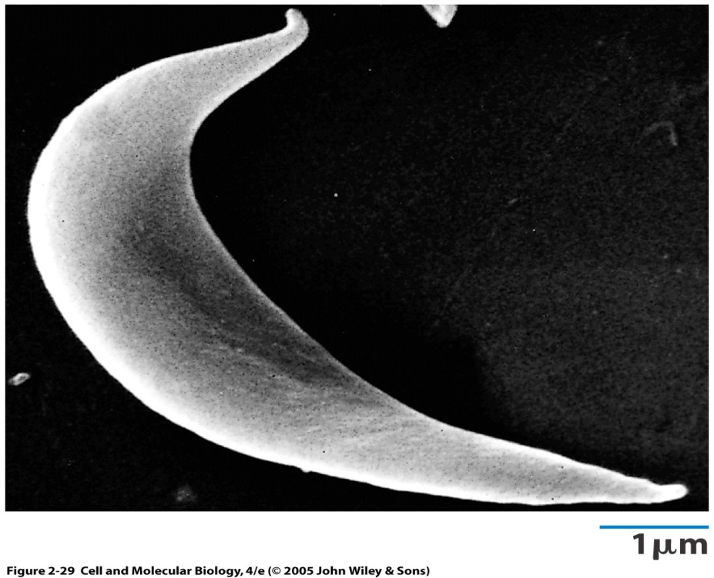
Protein conformation can be extremely sensitive to changes in amino acid sequence
Normal red blood cell
Abnormal sickle red blood cell
Sickle cell anemia is caused by a single mutation from glutamic acid to valine (charged to nonpolar)
Sickle cell disease associated with malaria.
http://www.sciencedaily.com/releases/2011/04/110428123931.htm
Notes:
Changes in amino acid sequence can occur through mutation, post-translational processing or other.
Sickle cells are stiff and sticky. They tend to block blood flow in the blood vessels of the limbs and organs.
Blocked blood flow can cause pain and organ damage. It can also raise the risk for infection.

Slide 39
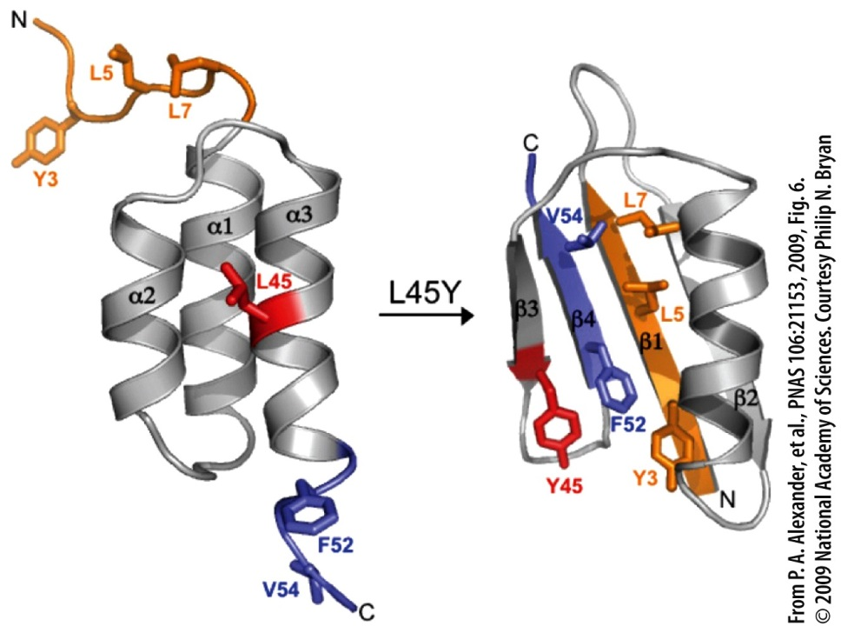
Protein structure alteration from a single amino acid change.
Protein Adaptation and Evolution
Adaptations are traits that improve the chance of survival of an organism in a specific environment.
Proteins are subject to natural selection.
Members of a protein family are thought to have evolved from a single ancestor gene.
A particular protein may have different versions (isoforms) that are tissue- or stage-specific.
Notes:
Figure 2.54
The dramatic effect on conformation that can result from a single amino acid substitution. In this case the substitution of a leucine for a tyrosine at a critical position within this 56-amino acid polypeptide chain results in a transformation of the entire fold of the backbone of this polypeptide. This single substitution causes 85% of the amino acid residues to change their secondary structure. The spatial distribution of the two alternate side-chains, which brings about this conformational shift, is shown in the model structures. The N-terminal amino acids are shown in orange and the C-terminal amino acids in blue.

Slide 40
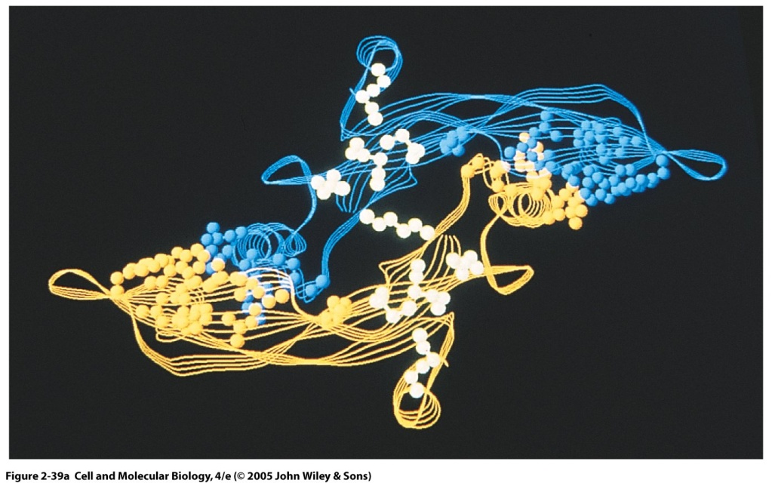
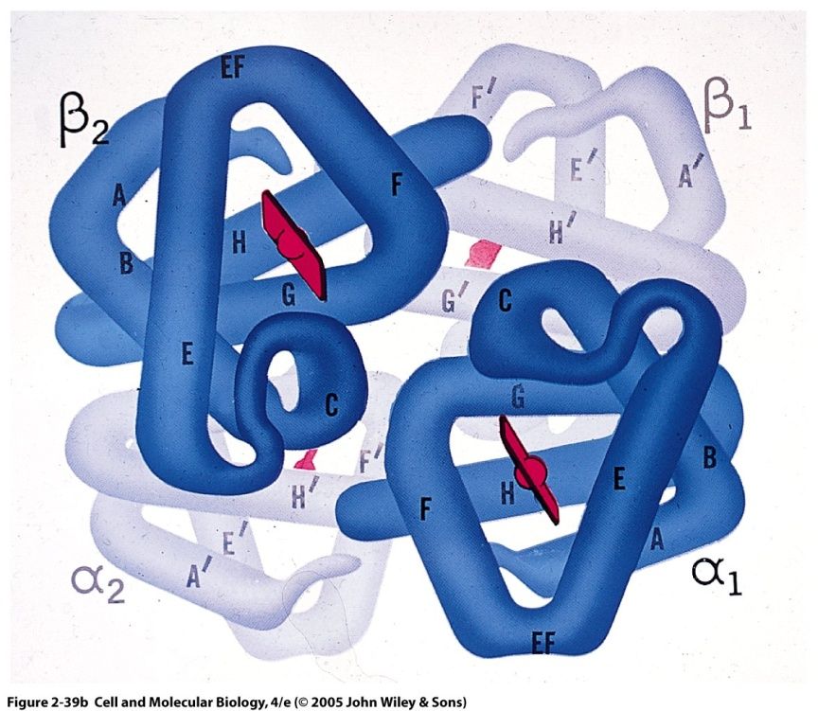
Quaternary protein structure occur when there are at least two protein subunits with tertiary structure
Different subunits are typically linked by non-covalent bonds
Left, transforming growth factor beta-2, consisting of two identical subunits (homodimer)
Right, hemoglobin, consisting of two alpha subunits and two beta subunits (heterotetramer, or two homodimers)
Review with video from Protein Data Bank: https://www.youtube.com/watch?v=qBRFIMcxZNM

Slide 41
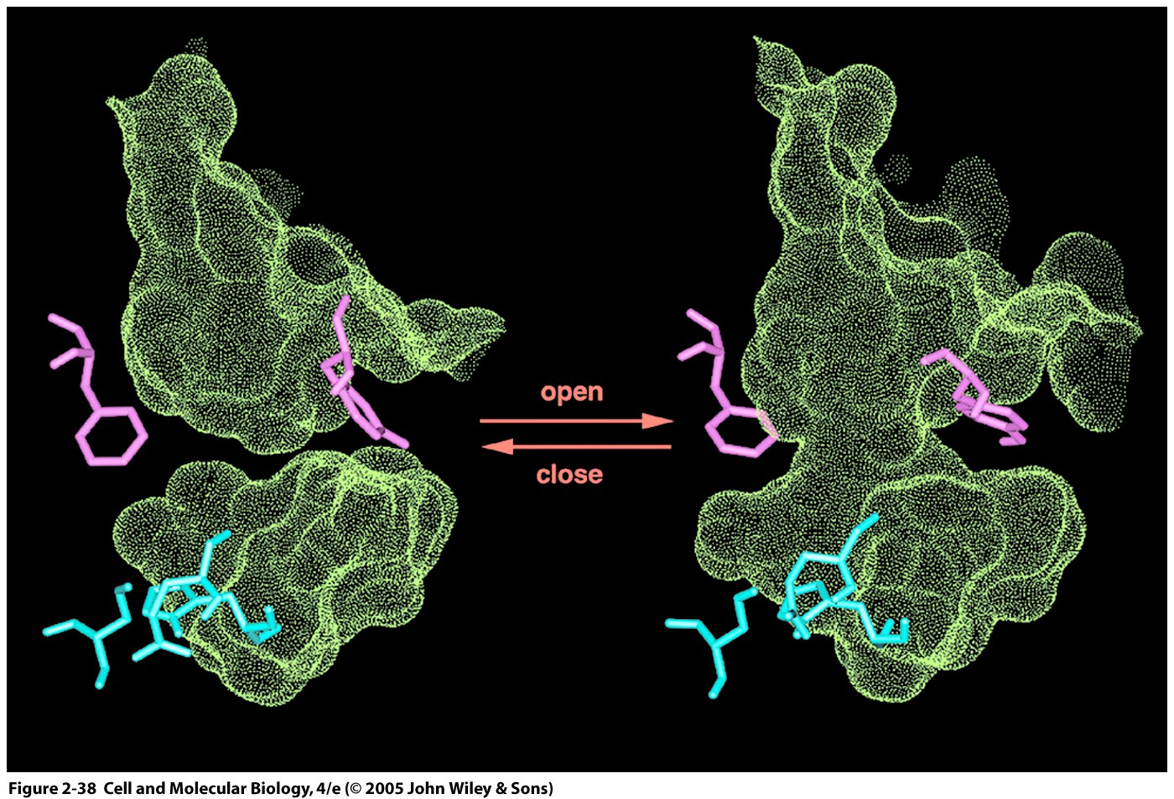
Together, subunits can determine open and closed states, which is particularly important for receptor proteins
Structure shown is acetylcholinesterase, which is an enzyme that breaks down the neurotransmitter acetylcholine.
Notes:
41

Slide 42
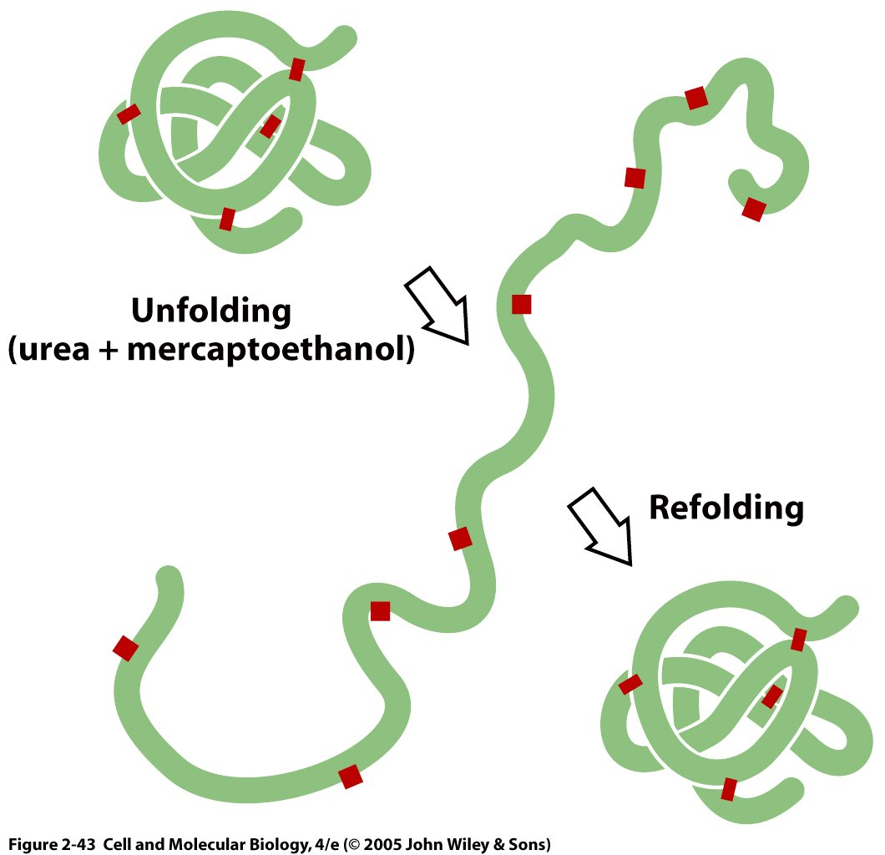
Many proteins’ conformations are repeatable and arise as a consequence of finding the lowest energy configuration
Don’t stress, relax!
The ability to re-form in a functional manner is called self-assembly.
Notes:
42
Urea denatures protein by getting into the hydrophobic core and reducing the hydrophobicity relative to its surroundings.

Slide 43
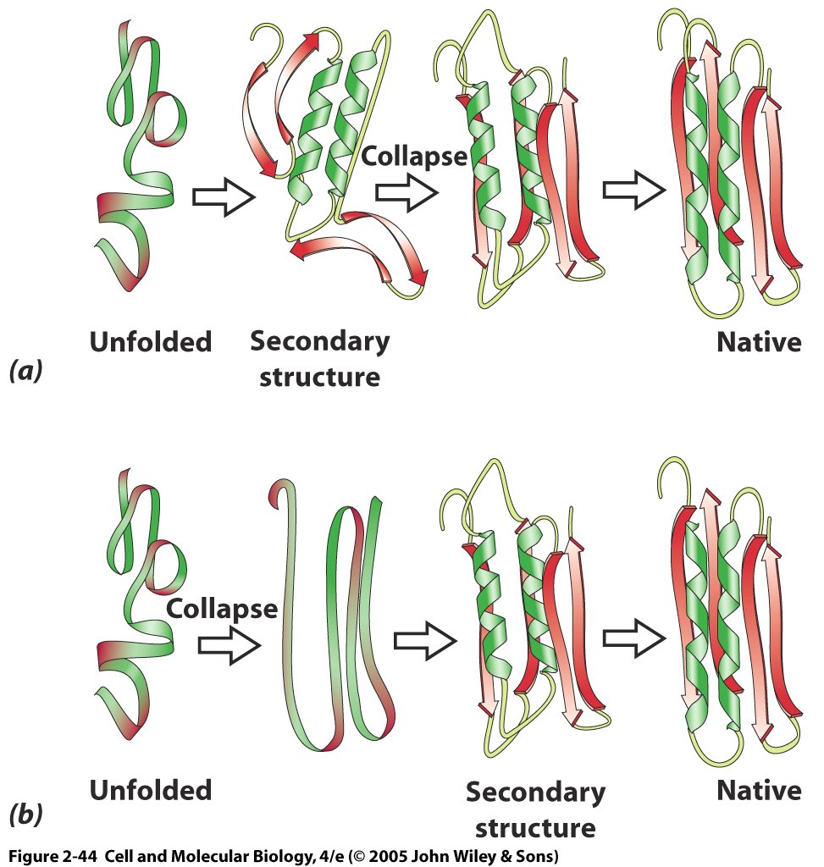
What are the steps in protein folding?
Scenario 1: The unfolded chain forms secondary structure, and then tertiary structure through hydrogen bonding and hydrophobic interactions.
Scenario 2: The unfolded chain compacts first, then forms secondary structure, and finalizes tertiary structure.
Actual folding is between these two extremes, simultaneous local formation of helices and sheets through local hydrogen bonding and hydrophobic interactions.
Notes:
43

Slide 44
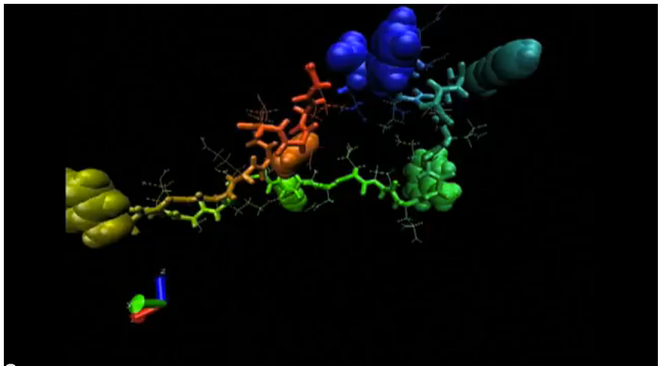
Video of protein folding
http://www.youtube.com/watch?v=1eSwDKZQpok

Slide 45
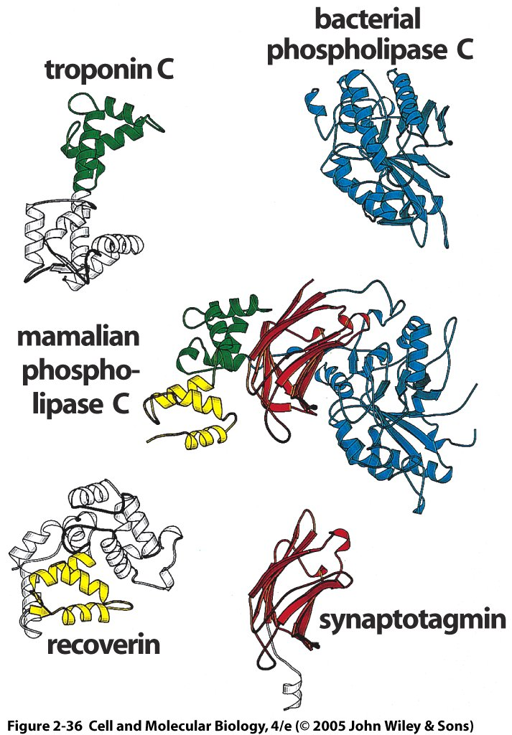
Larger proteins and more evolved proteins often consist of domains
Phospholipase C is involved in many intracellular signaling pathways triggered by activation of membrane receptors. Mammalian PLC consists of 4 domains:
Catalytic domain from bacterial PLC
Synaptotagmin (Ca2+ sensor)
Recoverin (Ca2+ triggered receptor)
Troponin C (binds Ca2+ to produce movement in muscle)

Slide 46
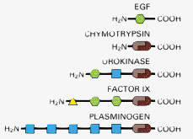
Domain shuffling: recycling on an evolutionary time scale
The same domains, such as the brown serine protease domains, are re-used in different cellular proteins, typically with the same functions across proteins. Modularity!
Alberts et al. Molecular Biology of the Cell

Slide 47
Clicker Question
What would you expect if two proteins had the same protein domains?
The domain amino acid sequences would be conserved, meaning highly similar.
The domains would have similar quaternary structure.
The domains would have similar functions.
Answers A and C.
Answers B and C.
All of the above

Slide 48
Summary
Macromolecules are defined by their atoms and the bonds the connect them.
Proteins come in a wide variety of sequences, sizes, and shapes
All molecular structures are Gibbs free energy minimizers

Slide 49
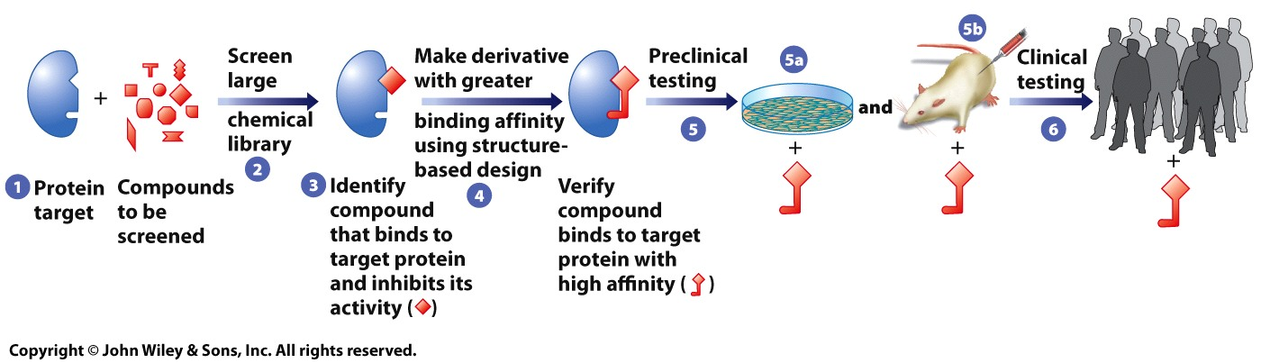
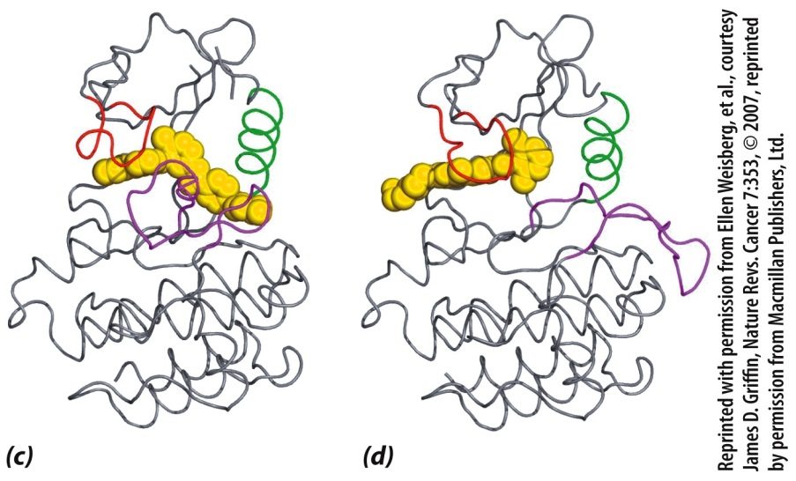
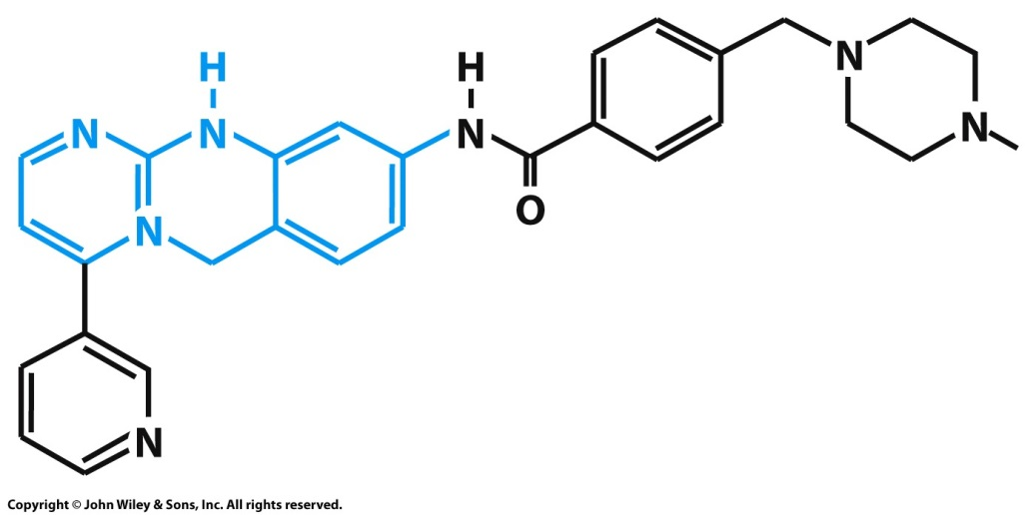
Development of a protein-targeting drug
Four Types of Biological Molecules
Gleevac structure
ABL protein-targeting with Gleevac (L) and Sprycel (R)
Notes:
Figure 2.52a-c
Development of a protein-targeting drug, such as Gleevec. (A) Typical steps in drug development. In step 1, a protein (e.g., ABL) has been identified that plays a causative role in the disease. This protein is a likely target for a drug that inhibits its enzymatic activity. In step 2, the protein is incubated with thousands of compounds in a search for ones that bind with reasonable affinity and inhibit its activity. In step 3, one such compound (e.g, 2-phenylaminopyrimidine in the case of ABL) has been identified. In step 4, knowledge of the structure of the target protein is used to make derivatives of the compound (e.g., Gleevec) that have greater binding affinity and thus can be used at lower concentrations. In step 5, the compound in question is tested in preclinical experiments for toxicity and efficacy (level of effectiveness) in vivo. Preclinical experiments are typically carried out on cultured human cells (step 5a) (e.g., those from patients with CML) and laboratory animals (step 5b) (e.g., mice carrying transplants of human CML cells). If the drug appears safe and effective in animals, the drug is tested in clinical trials (step 6). (B) The structure of Gleevec. The blue portion of the molecule indicates the structure of the compound 2-phenylaminopyrimidine that was initially identified as an ABL kinase inhibitor. (C, D ) The structure of the catalytic domain of ABL in complex (C) with Gleevec (shown in yellow) and (D) with a second-generation inhibitor called Sprycel. Gleevec binds to the inactive conformation of the protein, whereas Sprycel binds to the active conformation. Both binding events block the activity that is required for the cell’s cancerous phenotype. Sprycel is effective against cancer cells that have become resistant to the action of Gleevec.

Slide 50
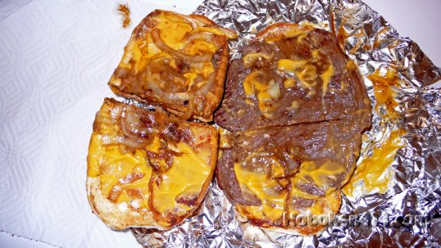
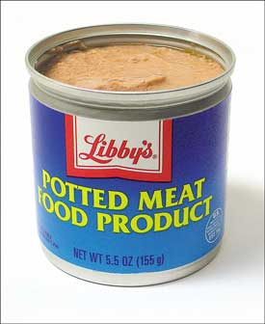
Mystery meat: Methods for protein identification, sequencing and interactions

Slide 51
The problem: Genomic and proteomic analyses have revealed thousands of proteins with unknown functions or interactions
Proteome = Inventory of proteins produced by an organism. It may be subdivided by cell type, tissue type, etc. Proteomics are studies of the proteome.
From Karp p. 68 – “ The human genome contains roughly 25,000 genes, each of which can potentially give rise to a variety of different proteins. To date, only a fraction of these molecules have been characterized.”

Slide 52
Problem 1: Get a pure protein sample to analyze
What characteristics can be used to identify proteins?
Size
Charge
Enzymatic Activity
Sequence
Secondary structure
Interactions with other proteins
Location in cell (membrane bound, mitochondrial, nuclear, etc.)
Appearance during development (embryonic, adult, dividing, etc.)
Notes:
Let’s see how far the class can get with hints here.

Slide 53
The problem: Genomic and proteomic analyses have revealed thousands of proteins with unknown functions or interactions
Proteome = Inventory of proteins produced by an organism. It may be subdivided by cell type, tissue type, etc. Proteomics are studies of the proteome.
From Karp p. 68 – “The human genome contains roughly 25,000 genes, each of which can potentially give rise to a variety of different proteins. To date, only a fraction of these molecules have been characterized.”

Slide 54
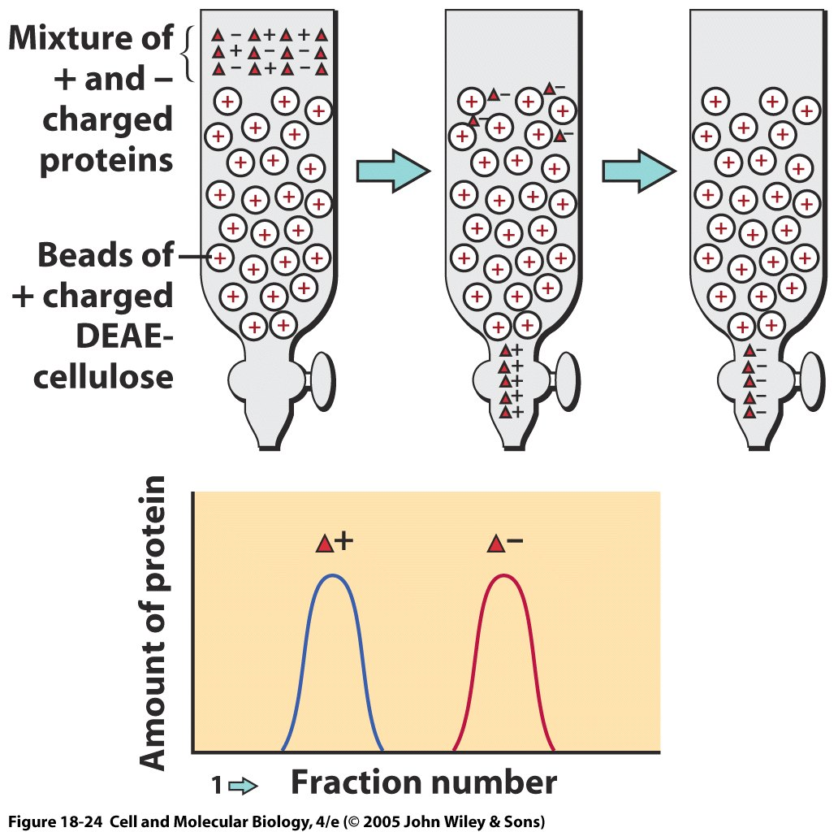
Chromatography
Mixture fractionated as it moves through a porous matrix
Mobile phase, protein in solvent
Immobile phase, protein caught in matrix
Fractions of solvent are captured at different time points
Proteins with least matrix affinity in first fraction, those with most in later fractions or captured in matrix
Notes:
This example shows ion-exchange chromatography

Slide 55

Gel exclusion chromatography (size filtration)
 | lower limit | upper limit
dextran gels
Sephadex G-50 | 1.5 | 30
Sephadex G-75 | 3 | 80
Sephadex G-100 | 4 | 150
Sephadex G-150 | 5 | 300
Sephadex G-200 | 5 | 600
polyacrylamide gels
Bio-Gel P-10 | 1.5 | 20
Bio-Gel P-30 | 2.5 | 40
Bio-Gel P-60 | 3 | 60
Bio-Gel P-100 | 5 | 100
Bio-Gel P-150 | 15 | 150
BioGel P-200 | 30 | 200
Bio-Gel P-300 | 60 | 400
dextran-polyacrylamide gels
Sephacryl S-200 | 5 | 250
Sephacryl S-300 | 10 | 1500
Sephacryl S-400 | 20 | 8000
agarose gels
Sepharose 6B | 10 | 4000
Sepharose 4B | 60 | 20,000
Sepharose 2B | 70 | 40,000
Bio-Gel A-0.5 | 10 | 500
Bio-Gel A-1.5 | 10 | 1500
Bio-Gel A-5 | 10 | 5000
Bio-Gel A-15 | 40 | 15,000
Bio-Gel A-50 | 100 | 50,000
http://www.ucl.ac.uk/~ucbcdab/enzpur/gelexcl.htm

Slide 56
Ion-exchange chromatography
Use charged matrix to attract oppositely charged proteins
Can vary pH of solvent to vary protein charge (Why?)
Isoelectric point = the pH at which the protein is neutral (typically not pH=7)
Can also have gel-filtration chromatography (by size)
Notes:
This example shows ion-exchange chromatography

Slide 57

Clicker Question
Gel filtration or gel exclusion chromatography:
Small molecules have a faster average velocity, and hence elute earlier from the column.
Small molecules have a slower average velocity, and hence elute earlier from the column.
Large molecules have a faster average velocity, and hence elute earlier from the column.
Large molecules travel slower average velocity, and hence elute earlier from the column.
Notes:
This example shows ion-exchange chromatography

Slide 58


Affinity chromatography
Useful if you have a known or desired target or ligand
Only proteins that bind to the target will remain in the column
Can dissociate bound protein by changing pH
Depending on initial protein mixture, may get closely related proteins or multiple bound proteins

Slide 59

How do you know you have the right protein?
Enzyme assays. If the solution loses the ability to catalyze a reaction, then the enzyme has either passed through the column or is bound in the matrix.
Binding assays. Typically, a radioactive ligand is put together with your protein of interest (a receptor usually). Unbound ligand is removed. Radioactive decay is detected with a scintillation counter.
Sequence it. Sequencing lab or…mass spectrometry
http://www.ncgc.nih.gov/guidance/section5.html#filtration-assays

Slide 60

Mass spectrometry, it’s a gas!
Widely used and powerful way to identify and sequence a protein
First, digest the protein enzymatically to break it into small peptide fragments
Then, vaporize it. In matrix-assisted laser desorption ionization (MALDI), the protein is embedded in a crystal matrix that is vaporized by a laser pulse. The crystal matrix contains materials which will serve as reference points in the mass spectrogram.
In electrospray ionization (ESI), the protein solution is vaporized by application of an electric potential. The protein solution could be obtained from a fraction from chromatography
Notes:
60
http://www.youtube.com/watch?v=a5aLlm9q-Xc
Matrix-Assisted Laser Desorption Ionization (MALDI) typically utilizes a nitrogen laser at 337nM as the ionization source. The sample is mixed with a matrix, and allowed to dry prior to insertion into the mass spectrometer. Crystallization of the sample within the matrix is an important component of successful MALDI analysis. A variety of matrices, present in great excess relative to the sample amount, are used to span the range of compounds classes amenable to MALDI mass analysis. Formation of sample ions, upon laser irradiation, involves a proton transfer reaction involving the matrix (which absorbs the UV photon) and the analyte. The ions are then accelerated into a time-of-flight mass analyzer for mass analysis. Typical matrices include, a-cyano-4-hydroxycinnamic acid, sinapinic acid and 2,5-dihydroxybenzoic acid. MALDI can be done routinely to m/z 100,000 and there are many examples of analyses going well above this mass range

Slide 61

Mass spectrometry 2
Vaporized peptide fragments pass through a magnetic field that separates them by their mass/charge ratio (m/z ratio).
The ions are accelerated and then deflected by the magnet according to their mass. Lighter fragments are deflected more.
The ion flux (number of ions/unit time) is detected at the detector for each mass, separated by time of arrival and position on detector.
Notes:
61

Slide 62
Mass spectrometry 3
Each protein will have a signature in the mass spectrometer
Can be compared with a database
Or some fragments can undergo another round of mass spectrometry at a finer level of detail to reveal the amino acid sequence, which is called tandem mass spectrometry.
In this case, fragments with a selected mass pass through a second mass spectrometer
Notes:
62

Slide 63
What if you have a mixture of unknown proteins or want to compare proteins across species or manipulations?
Modern mass spectrometry, especially tandem mass spectrometry, works quite well, but it requires more complicated analysis and can be expensive
Earlier and current methods often use another technique called…
Notes:
63

Slide 64

Gel electrophoresis
Can be one or two dimensional
Separate proteins by size and/or isoelectric point
Similar to chromatography in that a matrix alters movement of a protein.
Commonly use SDS-PAGE, or sodium dodecyl sulfate polyacrylamide gel electrophoresis.
Negatively charged SDS attach all over proteins and put in a voltage gradient.
Larger proteins move more slowly and remain near the top of the gel.
Example of one dimensional electrophoresis (size). Each column is a different sample.
Notes:
64
In SDS PAGE, SDS equalizes charge density of all proteins and only separator is mass

Slide 65

Two-dimensional gel electrophoresis
Two dimensions are typically mass and isoelectric point, the point at which the protein is neutral.
Can segregate most proteins in a cell simultaneously like this.
Notes:
65

Slide 66

Application of two-dimensional gel electrophoresis to compare human and chimpanzee proteins
Overall pattern is very similar between human (left) or chimpanzee tissue samples from frontal cortex (right)
Circled regions highlight differences between species, either as a shift in the position on the gel or in the intensity of the spot (amount of protein)
Proteins of interest can then be studied further, sometimes by simply removing the stained portion of interest containing the protein.
Notes:
66

Slide 67


X-ray diffraction can provide a high-resolution picture of protein tertiary crystal structure
Typical diffraction pattern
Sample must be a crystal, because need ordered repeating structure. Crystal creation lies at the science/magic interface (kidding, mostly)
A very short wavelength x-ray beam produces an interference pattern based on the positions of the atoms in the sample
The sample or beam can be moved to get the structure from all angles.
Notes:
67
Remember from physics that diffraction is the bending of a wave as it passes through an aperture or by an object
asinθ = nλ for a double slit, where a is the distance between slits and gives location of maximal interference
I. Steps in X-ray diffraction (X-ray crystallography) – must get most purified preparation of protein possible
A. Protein crystals are needed before X-ray crystallography can be used to characterize proteins
1. Crystal is composed of a regularly repeating arrangement of a unit cell (a single protein)
2. The ability to make a protein crystal is one of the best guarantees of molecular purity
B. Protein crystal, once formed, is bombarded with a fine X-ray beam of monochromatic wavelength
1. Radiation that is scattered (diffracted) by electrons of protein's atoms strikes an electron-sensitive detector placed behind the crystal
2. Diffraction pattern produced by the crystal is determined by the structure within protein; atoms in the crystal are in a repeating pattern,
3. The large number of molecules in crystal reinforces reflections —> it behaves like one large molecule
II. Data obtained
A. Reflection positions & intensities on plates are related mathematically to protein electron densities, since it is the electrons of the atoms that produced them; reflections appear as spots on plates
1. Because of the way in which the crystal is bombarded, each plate represents a slice of molecule; one must analyze many plates to get a single diffraction pattern
2. Resolution obtained by X-ray diffraction depends on the number of spots that are analyzed
B. Spots closer to pattern center result from X-rays scattered at smaller angles from crystal; provide information about grosser aspects of protein (long spacings within molecule)
C. Spots closer to periphery of photograph contain information about closely spaced aspects of molecules within crystal —> resolution depends on the number of spots analyzed
III. Example: myoglobin, first protein whose structure was determined by X-ray diffraction; analyzed successively at resolutions of 6, 2 & 1.4 Å, with years elapsing between each completed determination
A. Since covalent bonds are 1 - 1.5 Å in length & noncovalent bonds are between 2.8 Å & 4Å in length, information gathered on protein depends on resolution achieved
B. In myoglobin, at 6 Å resolution —> showed manner in which myoglobin polypeptide chain is folded & the location of the heme moiety, but it is not sufficient to show structure within chain
1. At 2 Å resolution —> groups of atoms could be separated from one another
2. At 1.4 Å resolution —> positions of individual atoms were determined
C. By the end of 2002, the structure of >250 proteins had been determined at atomic resolution (>1.2 Å) & a handful as low as 0.8 Å
http://www.youtube.com/watch?v=ejqleVj4plE

Slide 68

X-ray diffraction can give extremely precise structural information
Down to ≤1 angstrom, where individual electron density patterns can be detected
Computational power for reconstructing diffraction patterns enables tertiary structure calculations within a day
Difficult for membrane proteins, because structure often changes if removed from membrane
Notes:
68

Slide 69
Crystal structure of p53 tumor suppressor protein
trans-activation
tetramerization
4 repeated subunits around central domain
Each subunit consists of a DNA-binding domain and a trans-activation domain.
From Protein Data Bank,
www.rcsb.org
DNA-binding
Notes:
p53 is a tumor suppressor protein that in humans is encoded by the TP53 gene. p53 is crucial in multicellular organisms, where it regulates the cell cycle and, thus, functions as a tumor suppressor that is involved in preventing cancer. As such, p53 has been described as "the guardian of the genome" because of its role in conserving stability by preventing genome mutation.

Slide 70

DNA binding domain of p53 along DNA chain
DNA on right
P53 DNA-binding domain on left, with key arginine in DNA minor groove in red.
Other important amino acids in pink.
Notes:
p53 is a tumor suppressor protein that in humans is encoded by the TP53 gene. p53 is crucial in multicellular organisms, where it regulates the cell cycle and, thus, functions as a tumor suppressor that is involved in preventing cancer. As such, p53 has been described as "the guardian of the genome" because of its role in conserving stability by preventing genome mutation.

Slide 71

Nuclear magnetic resonance (NMR) spectroscopy
Example protein: cellulase. Left: Two-D NMR spectrum. Right: Reconstructed structures satisfying constraints.
Chemical Shift RF-B
Alberts et al., Molecular Biology of the Cell
Chemical Shift- RF-A
NMR can bypass main constraint of x-ray crystallograpy because it requires protein in a solution, rather than a crystal.
Measures the emitted radiation from hydrogen atoms that have been forced to align by a strong magnetic field.
Can monitor changes in structure with binding, etc.
Notes:
71
http://www.cem.msu.edu/~reusch/VirtualText/Spectrpy/nmr/nmr1.html
http://www2.chemistry.msu.edu/faculty/reusch/VirtTxtJml/Spectrpy/nmr/nmr1.htm
may operate by sweeping the magnetic field. Using this terminology, we would find that at 2.34 T the proton signals shown above extend over a 4,200 Hz range (for a 100 MHz rf frequency, 42 ppm is 4,200 Hz). Most organic compounds exhibit proton resonances that fall within a 12 ppm range (the shaded area), and it is therefore necessary to use very sensitive and precise spectrometers to resolve structurally distinct sets of hydrogen atoms within this narrow range. In this respect it might be noted that the detection of a part-per-million difference is equivalent to detecting a 1 millimeter difference in distances of 1 kilometer.
Nice NMR tutorials
Unlike x-ray crystallography, NMR does not depend on having a crystalline sample; it simply requires a small volume of concentrated protein solution that is placed in a strong magnetic field.
Certain atomic nuclei, and in particular those of hydrogen, have a magnetic moment or spin: that is, they have an intrinsic magnetization, like a bar magnet. The spin aligns along the strong magnetic field, but it can be changed to a misaligned, excited state in response to applied radiofrequency (RF) pulses of electromagnetic radiation. When the excited hydrogen nuclei return to their aligned state, they emit RF radiation, which can be measured and displayed as a spectrum.
Chemical shift is the change in resonant frequency due to the local environment. Small changes in frequency 100 Hz out of 100-900 MHz. In 2-D NMR shown, experiment is a series of RF pulses whose characteristics are highly controlled. Off-diagonal peaks are coupled hydrogens. Often pulse interval varied.
For technical reasons the structure of small proteins of about 20,000 daltons or less can readily be determined by NMR spectroscopy. Resolution is lost as the size of a macromolecule increases. But recent technical advances have now pushed the limit to about 100,000 daltons, thereby making the majority of proteins accessible for structural analysis by NMR.
The NMR method is especially useful when a protein of interest has resisted attempts at crystallization, a common problem for many membrane proteins. Because NMR studies are performed in solution, this method also offers a convenient means of monitoring changes in protein structure, for example during protein folding or when a substrate binds to the protein. NMR is also used widely to investigate molecules other than proteins and is valuable, for example, as a method to determine the three-dimensional structures of RNA molecules and the complex carbohydrate side chains of glycoproteins.
Figure 8-46. NMR spectroscopy. (A) An example of the data from an NMR machine. This two-dimensional NMR spectrum is derived from the C-terminal domain of the enzyme cellulase. The spots represent interactions between hydrogen atoms that are near neighbors in the protein and hence reflects the distance that separates them. Complex computing methods, in conjunction with the known amino acid sequence, enable possible compatible structures to be derived. In (B) 10 structures, which all satisfy the distance constraints equally well, are shown superimposed on one another, giving a good indication of the probable three-dimensional structure. (Courtesy of P. Kraulis.)

Slide 72
Cryo-EM can show detailed bacteriophage structure, resolution proportional to acceleration of electron beam
Jiang et al. 2006, Wen Jiang is in Bio. Dept, Purdue University
Notes:
72
72
Cryo-EM = cryo-electron microscopy
Figure 1 | Structure of epsilon15
bacteriophage. a, 200-kV CCD
image of epsilon15 particles
embedded in vitreous ice. b, Surface
rendering of the 20A ° resolution
three-dimensional map of entire
epsilon15 bacteriophage
reconstructed without symmetry
imposition. The capsid (dark green)
exhibits good icosahedral symmetry
as indicated by the icosahedral
lattice (grey). c, d, The structural
components of epsilon15
bacteriophage are annotated in the
central section density (c) and the
cut-away surface view (d) of the
three-dimensional density map.
Each of the structural components
is coloured differently and the same
colour scheme is used in Figs 1–3.
e, A slightly tilted view of the
coaxially packed dsDNA genome.
Only portions of the first and
second layers of dsDNA are shown
so that the three outermost layers
can be viewed. Colour gradient (light
blue to darker blue) is used in d and
e to indicate the likely packaging
order of the dsDNA starting from
the outer layer towards inner layers
and ending as the central straight
segment of terminus.

Slide 73

Bacteriophages are complex viruses that infect bacteria.
They consist of:
A polyhedral head that contains DNA
A stalk through which DNA is injected
Tail fibers to attach to bacteria
Notes:
73
73
Bacterial viruses (bacteriophages) are among most complex – T bacteriophages polyhedral head (contains DNA), cylindrical stalk (injects DNA into bacterium) & tail fibers (attach to bacteria)
1. Used in key experiments that revealed genetic material structure & properties

Slide 74
Now we have been able to identify the sequence and structure of one protein. Can we find out anything about who the protein interacts with?
Notes:
74

Slide 75

The yeast two-hybrid system detects interactions
(Top) Normal case. Activation domain and DNA binding domain needed for transcription of lacZ (beta-galactosidase reporter gene)
If only DNA binding domain fused to protein X, no transcription.
A battery of potential protein Ys are bound to an activation domain
Only when an interaction occurs with protein X (shown in d but not e) will transcription occur.
Notes:
75
The fused proteins must be minimally altered to still have interactions, which is why e is necessary
The yeast two-hybrid system for detecting protein-protein interactions. The target protein is fused to a DNA-binding domain that localizes it to the regulatory region of a reporter gene as “bait.” When this target protein binds to another specially designed protein in the cell nucleus (“prey”), their interaction brings together two halves of a transcriptional activator, which then switches on the expression of the reporter gene. The reporter gene is often one that will permit growth on a selective medium. Bait and prey fusion proteins are generated by standard recombinant DNA techniques. In most cases, a single bait protein is used to fish for interacting partners among a large collection of prey proteins produced by ligating DNA encoding the activation domain of a transcriptional activator to a large mixture of DNA fragments from a cDNA library.

Slide 76

Example of lacZ stained cells
http://www.bio.davidson.edu/courses/genomics/method/reporters.html
Notes:
76
Perhaps the most common use of lacZ is for blue/white selection when cloning a DNA insert into a plasmid (figure 3). If the plasmid contains a version of lacZ with a polylinker, then you can determine visually whether you have cloned the insert or not. If the insert is ligated into the polylinker, then the lacZ gene will be disrupted and the colony will be white. If no insert is incorporated into the plasmid, the lacZ gene is left intact and it is able to produce β-galactosidase and the colon will turn blue. Notice in how some colonies are dark blue, some are light blue and others are pure white. You can tell that this system is not 100% error free. In fact, if the insert is a multiple of three base pairs in size, it might be possible to create an inframe insertion and still produce blue colonies. Nevertheless, blue/white selection is a helpful way to visually screen the success of your ligation and transformation before isolating plasmid DNA.

Slide 77

Fluorescence resonance energy transfer: Protein interactions? No worries, just FRET
Often used to measure changes in interactions between proteins or within a protein due to conformational changes
The unbound protein X that has been labeled with fluorescent protein will emit blue photons when excited by violet light using BFP as the fluorophore.
Binding of the protein Y to X changes the conformation and through FRET, changes the emitted light to green using GFP as the fluorophore.
Notes:
77
GFP, and its derivatives of different colors, can also be used to monitor protein-protein interactions. In this application, two proteins of interest are each labeled with a different fluorochrome, such that the emission spectrum of one fluorochrome overlaps the absorption spectrum of the second fluorochrome. If the two proteins—and their attached fluorochromes—come very close to each other (within about 1–10 nm), the energy of the absorbed light will be transferred from one fluorochrome to the other. The energy transfer, called fluorescence resonance energy transfer (FRET), is determined by illuminating the first fluorochrome and measuring emission from the second (Figure 8-49). By using two different spectral variants of GFP as the fluorochromes in such studies, one can monitor the interaction of any two protein molecules inside a living cell.
Figure 8-49. Fluorescence resonance energy transfer (FRET). To determine whether (and when) two proteins interact inside the cell, the proteins are first produced as fusion proteins attached to different variants of GFP. (A) In this example, protein X is coupled to a blue fluorescent protein, which is excited by violet light (370–440 nm) and emits blue light (440–480 nm); protein Y is coupled to a green fluorescent protein, which is excited by blue light and emits green light (510 nm). (B) If protein X and Y do not interact, illuminating the sample with violet light yields fluorescence from the blue fluorescent protein only. (C) When protein X and protein Y interact, FRET can now occur. Illuminating the sample with violet light excites the blue fluorescent protein, whose emission in turn excites the green fluorescent protein, resulting in an emission of green light. The fluorochromes must be quite close together—within about 1–10 nm of one another—for FRET to occur. Because not every molecule of protein X and protein Y is bound at all times, some blue light may still be detected. But as the two proteins begin to interact, emission from the donor GFP falls as the emission from the acceptor GFP rises.
See also http://www.olympusfluoview.com/applications/fretintro.html

Slide 78
Clicker Question
How would you identify a mystery protein if it was in a mix of other proteins and was soluble in water?
Use mass spectroscopy to pass the liquid mixture through a magnetic field that separates fragments by their mass/charge ratio (m/z ratio)
Crystalize the protein and use NMR spectroscopy
Use a yeast two-hybrid system to quantify fluorescence resonance energy transfer
Use chromatography to separate from proteins of other sizes, then use x-ray diffraction if the molecule can be crystalized (or NMR spectroscopy if it can not)
Notes:
78

Slide 79
How would you ID a mystery protein if:
You had a protein crystal
X-ray diffraction
You had to extract it from a mix of proteins
Chromatography
It had to be in solution
NMR spectroscopy
You wanted to find proteins that interacted with a specific protein of interest
Yeast two-hybrid system
FRET
Notes:
79

Slide 80
Summary
Protein interactions are specific
Protein identification
Chromatography
Mass spectroscopy
Gel electrophoresis
X-ray diffraction
Electron microscopy
Protein function
Yeast two hybrid system
Fluorescence energy transfer

